Slide 1
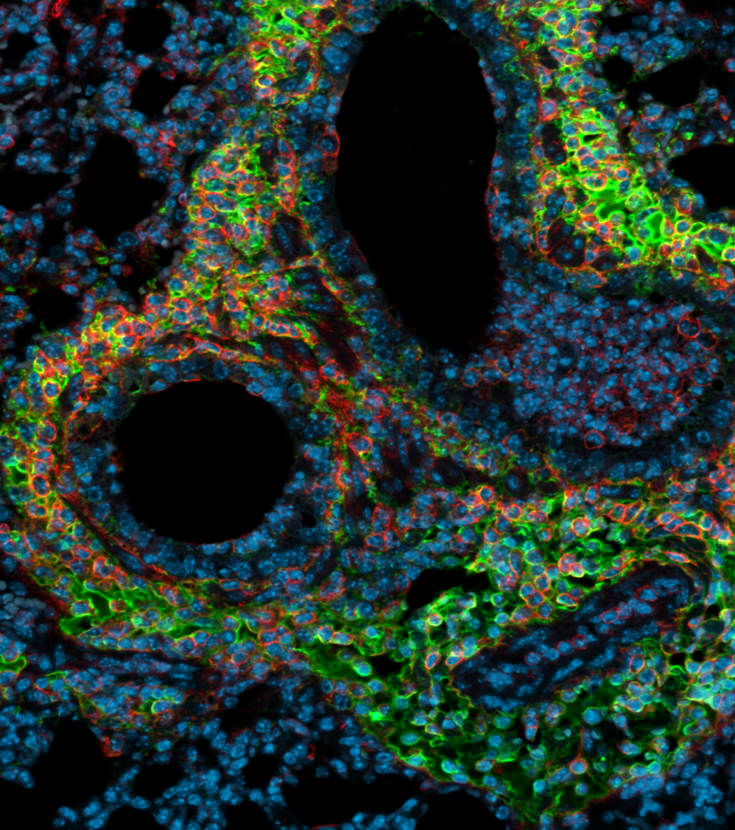
Decision making in lung immunity
Professor Tracy Hussell
tracy.hussell@manchester.ac.uk
Director, Lydia Becker Institute of
Immunology and Inflammation
University of Manchester, UK.
Tracy.hussell@manchester.ac.uk
Tissue complexity
Homeostasis
Normal processes that do not stop
<number>

Slide 2
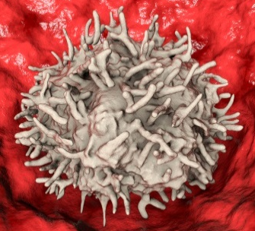
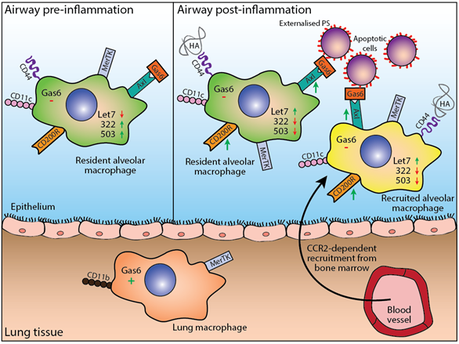
Multiple factors affecting macrophage inflammatory tone

Slide 3
Blind folding airway macrophages: miRNA modifications
Naive
Resolved
Dr Alexander Godlee
Notes:
polycistrionic miRNA clusters

Slide 4
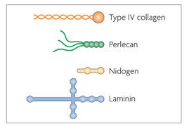
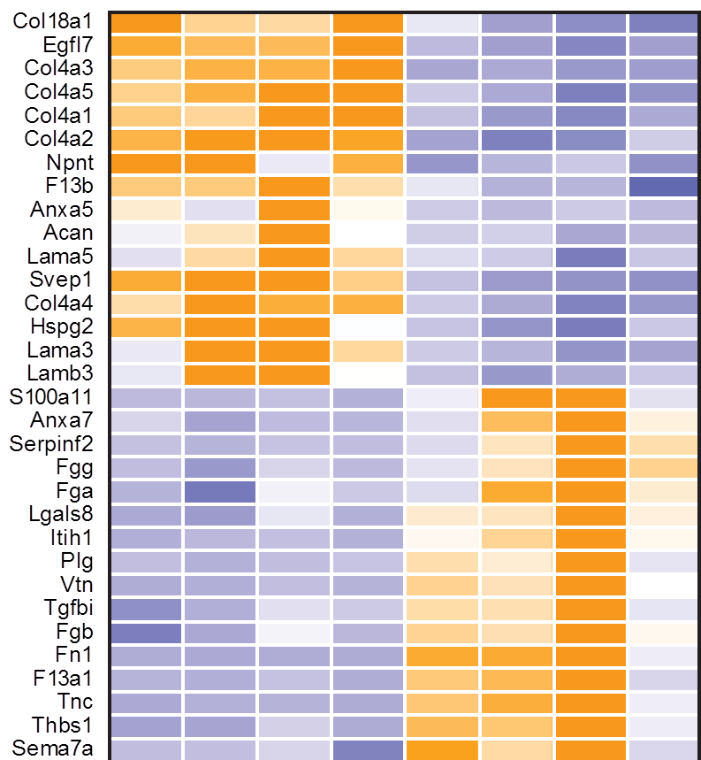
collagen type XVIII alpha 1 chain
Nephronectin: binds integrin α8β1
The impact of the extracellular matrix on inflammation. Lydia Sorokin
Nature Reviews Immunology volume 10, pages 712–723 (2010)000
Notes:
basement membranes are thin, tightly crosslinked networks (50–100 nm in thickness) that consist of 1–2 laminin isoforms, normally a singular type IV collagen isoform, nidogen 1 and/or nidogen 2, the heparan sulphate proteoglycan perlecan and several minor glycoproteins
<number>

Slide 5
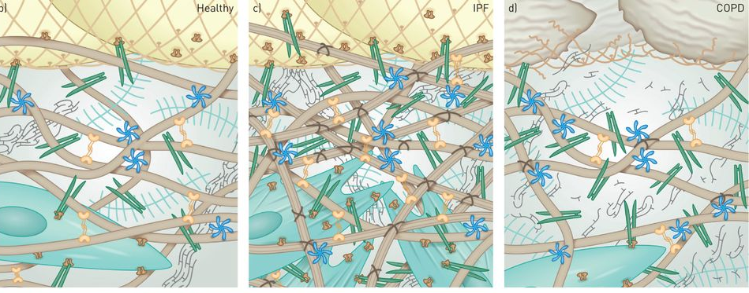
X-linked
fibrillar collagen
Basal membrane
Fibrillar collagen
Fibronectin
Hyaluronan
Fibroblast
Myofibroblast
Tenascin C
Integrins
The instructive extracellular matrix of the lung: basic composition and alterations in chronic lung disease
Gerald Burgstaller, Bettina Oehrle, Michael Gerckens, Eric S. White, Herbert B. Schiller, Oliver Eickelberg. European Respiratory Journal 2017, 50: 1601805; DOI: 10.1183/13993003.01805-2016

Slide 6
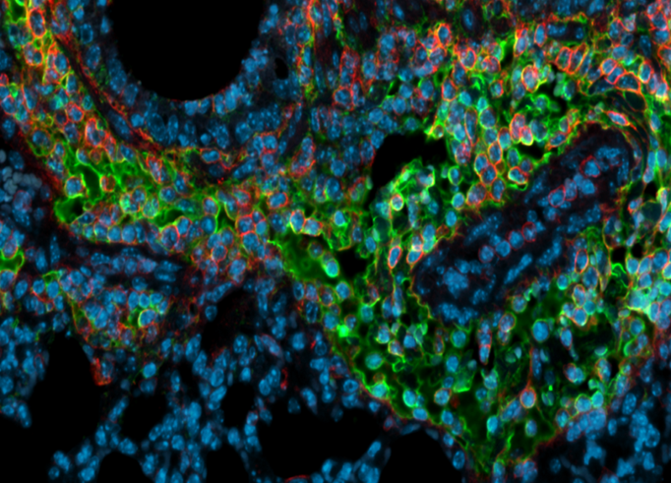
Hyaluronan is a major constituent of the inflamed lung

Slide 7
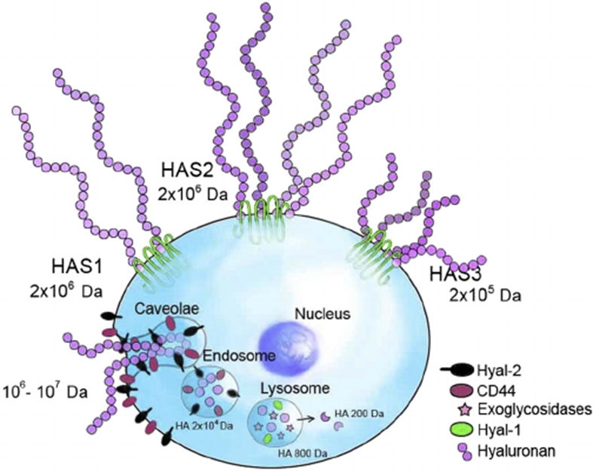
Why does matrix persist?
Production versus degradation
Notes:
<number>

Slide 8
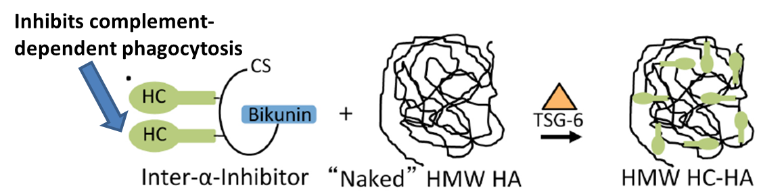
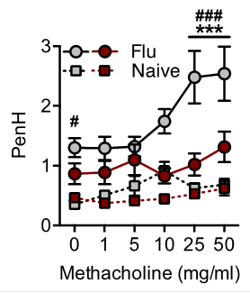
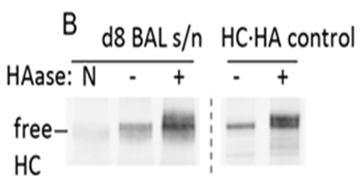
Digestion of HA restores lung function
Hyaluronidase at d15 after influenza

Slide 9
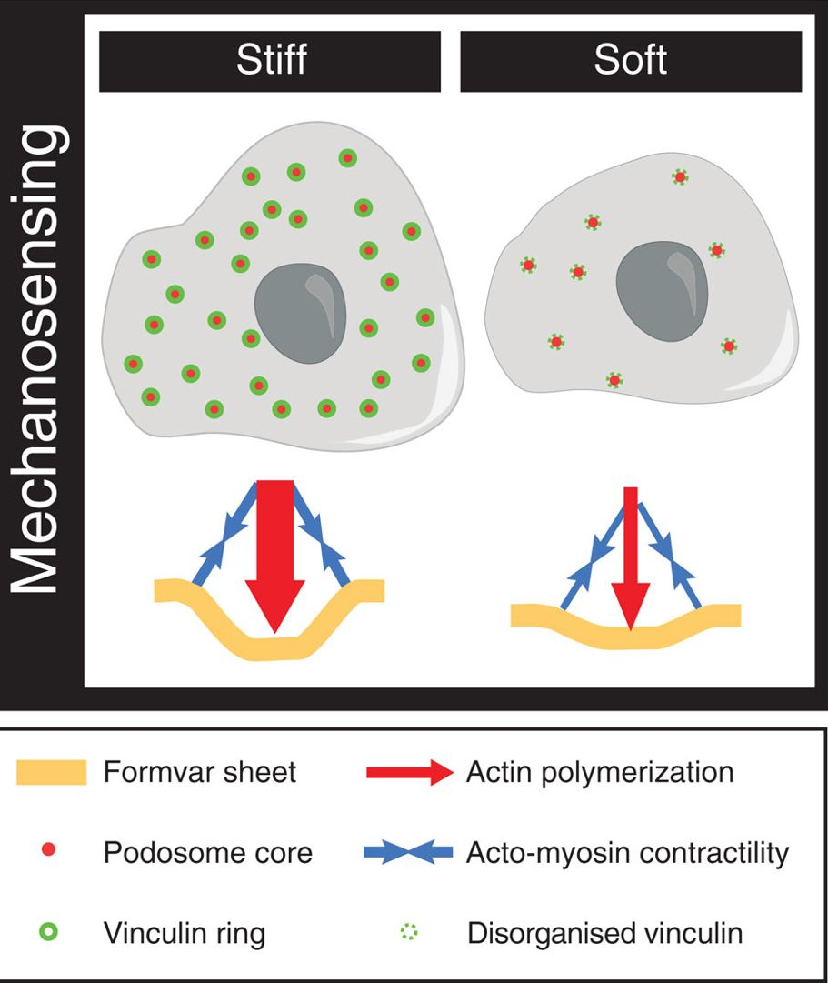
Mechanosensing podosomes exert a protrusive force that senses environment stiffness
F-actin-rich cone-shaped structures ~600 nm height and submicron diameter,
Located at the basal face of cells, perpendicular to, and in contact with, the substratum via integrins at the podosome ring
Typical lifespan of 10 min, with an actin turnover of ~30 s

Slide 10
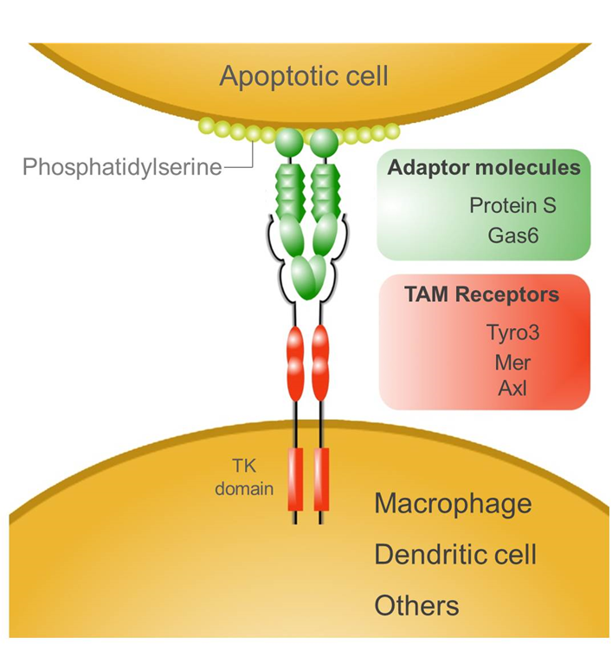
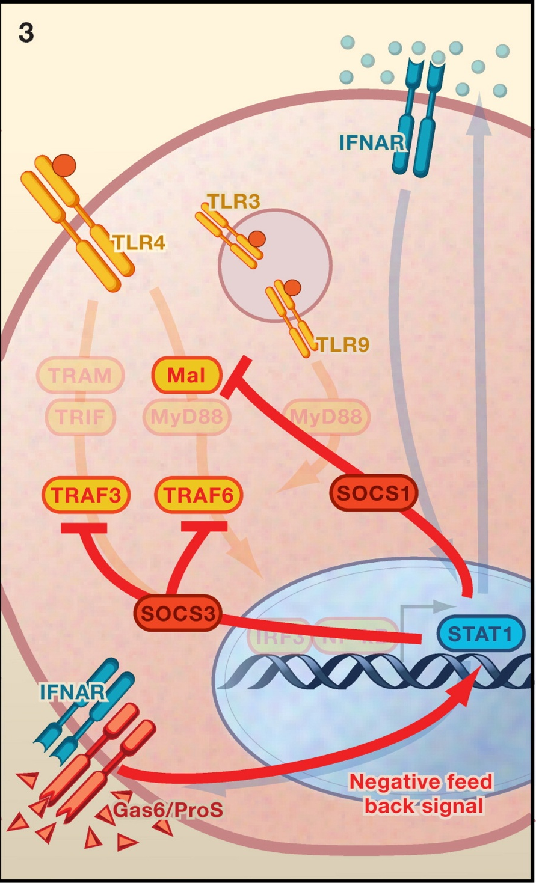
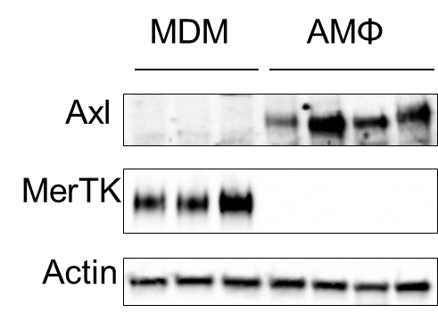
Cell death: A double edged sword in lung repair
Fujimori T, Grabiec AM, Kaur M, Bell TJ, Fujino N, Cook PC, Svedberg FR, MacDonald AS, Maciewicz RA, Singh D, Hussell T. Mucosal Immunol. 2015;8(5):1021-30.
Notes:
<number>
Mention collaboration with Rose
Rothlin et al. (2007) propose a tripartite model for TLR action. In the first stage (1), an initial response is triggered by TLRs via adaptor proteins that lead to activation of TRAF3 and TRAF6. In turn, TRAF3 and TRAF6 activate the transcription factors IRF3 and NF-κB, respectively, leading to production of cytokines, notably type I interferons, which promote host defense and inflammation. In the second stage (2), interferon signaling has a positive feedforward effect, promoting further interferon production via STAT1, thereby amplifying the response. However, in the third stage (3), interferons also induce inhibitory TAM receptors via STAT1 in a negative feedback effect. The TAM receptor ligands Gas6 and ProS also activate STAT1, which selectively induces production of SOCS1 and SOCS3. These proteins mediate the inhibition of TLR signaling by targeting Mal in the case of SOCS1 and TRAF3 and TRAF6 in the case of SOCS3. Together, this process allows the innate immune response to be launched but ultimately ensures that it is self-limiting and therefore not detrimental to the host

Slide 11



Differential expression of TAM receptors on human macrophage subsets
500
mono
MDM
AMΦ
MDM
AMΦ
250
Axl
relative mRNA expression
MerTK
50
Actin
25
0
CD36
BAI1
TIM1
TIM3
TIM4
Axl
MerTK
Tyro3
Grabiec AM, Denny N, Doherty JA, ……Fowler SJ, Simpson A, Hussell T.
Diminished airway macrophage expression of the Axl receptor tyrosine kinase
is associated with defective efferocytosis in asthma.
J Allergy Clin Immunol. 2017 Apr 12. (17)30585-7.

Slide 12
Cell death: A double edged sword in lung repair
sputum
AMΦ
10
4
**
10
1
***
10
3
10
0
relative sAxl levels [a.u.]
10
2
10
-1
10
-2
10
1
HD
asthma
HD
asthma
1.5
**
1.0
extracellular nucleosome [A₄₀₅]
0.5
0.0
HD
asthma

Slide 13
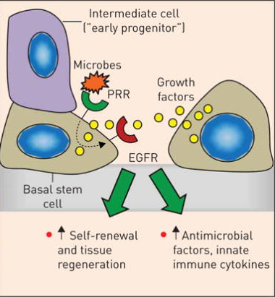
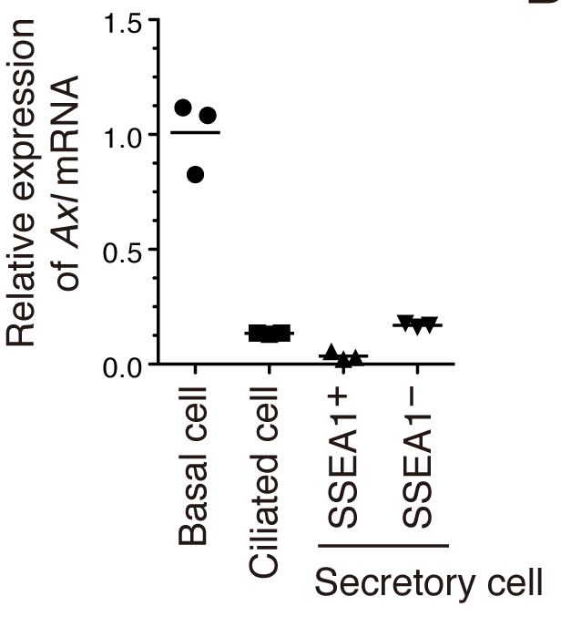
Apoptotic sensing by lung basal cells
Multitasking basal cells: combining stem cell and innate immune duties.
Shaykhiev R. Eur Respir J. 2015 Oct;46(4):894-7

Slide 14
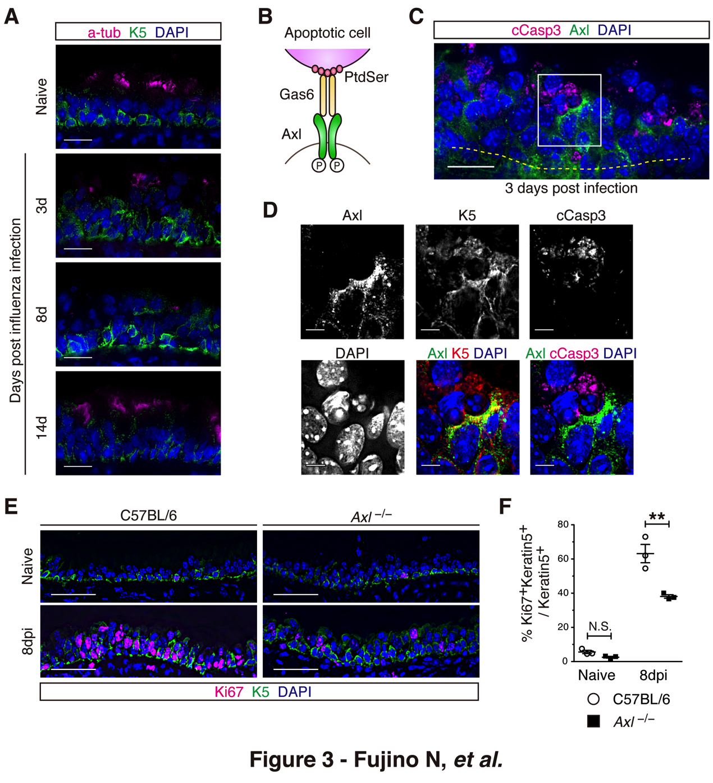
Basal cells respond to local cues: apoptotic cells
AXL drives basal cell proliferation

Slide 15
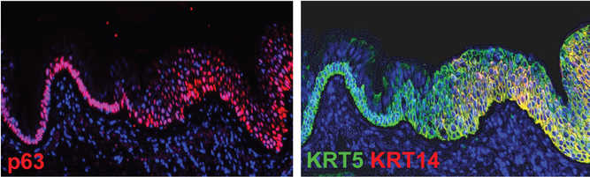
Basal cell hyperplasia
Rock JR, Randell SH, Hogan BL. Dis Model Mech. 2010 Sep-Oct;3(9-10):545-56.
Airway basal stem cells: a perspective on their roles in epithelial homeostasis and remodelling.

Slide 16
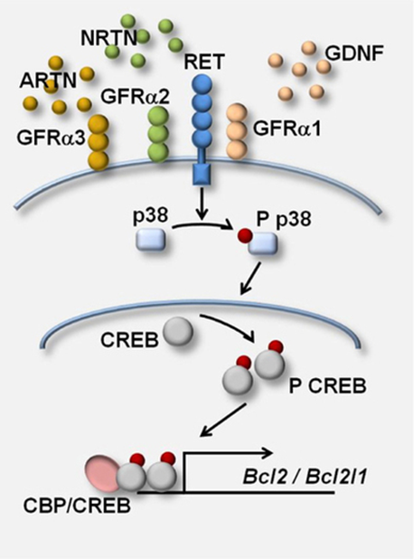
Epithelial macrophage cross-talk via the Glial cell line-derived neurotrophic factor family
Key roles in the control of neuron survival and differentiation.
Distant members of the TGF-β superfamily
Neurturin influences inflammatory responses and airway remodeling in different mouse asthma models.
Mauffray M, Domingues O, Hentges F, Zimmer J, Hanau D, Michel T. J Immunol. 2015;194(4):1423-33.

Slide 17
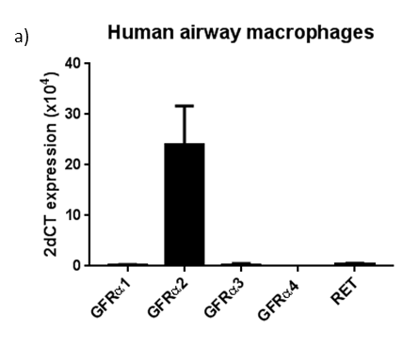
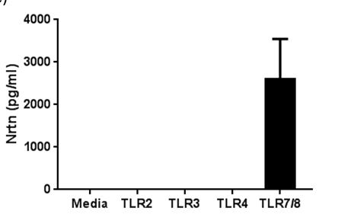
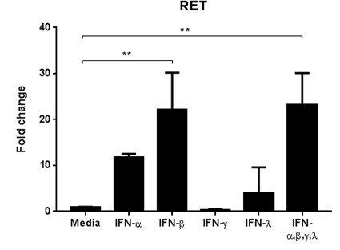
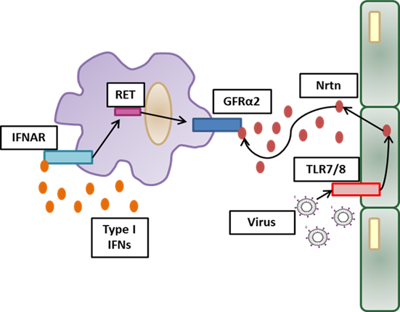
Neuturin and its receptor in the lung
Human Bronchial epithelial cells (Beas-2b)
Emma Connolly

Slide 18
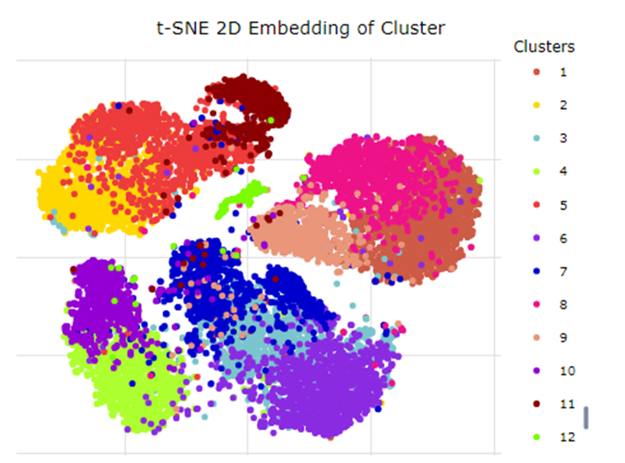
Not all cells are affected equally
Dr Sylvia Liu

Slide 19
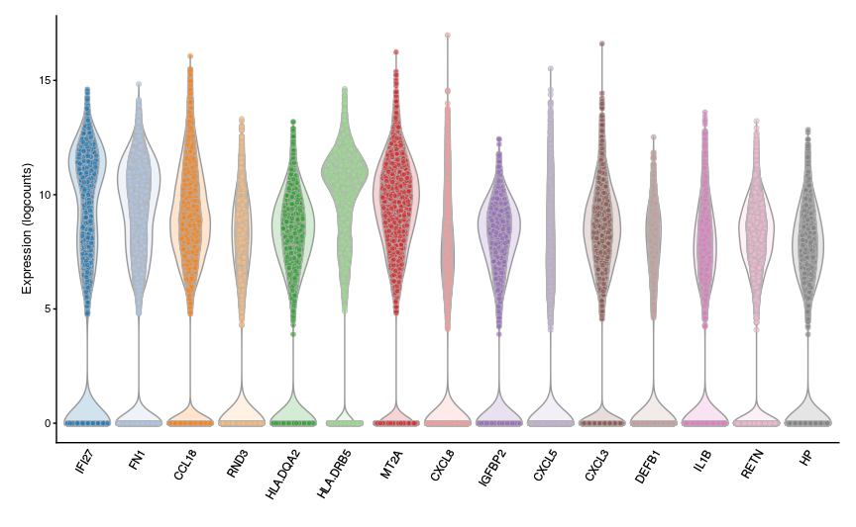
Most variable genes that define these clusters
IFN-response gene
Induces apoptosis
In same group as IFITM3/M2
Bind CXCR2
Recruits Mono and neuts
Notes:
DQA2 is capable of forming a complex with invariant chain
<number>

Slide 20
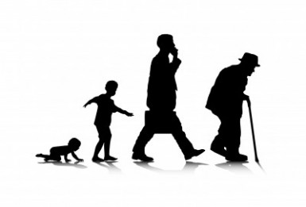
Where are the opportunities?
Health at different life stages
What drives change?

Slide 21
Do the same pathways explain immune deficits in infants?
 | Infants (n=20) | Adults (n=20)
Age, median(range) | 11 months (6-23) | 59 years (36-78)
BAL fluid instilled (mL), median | 15 (5-20) | 50 (40-100)
BAL fluid retrieval (%), median | 20 (5-40) | 40 (20-66)
AMφ yield (cells x 10⁵), median | 2.9 (1.8-18) | 2.35 (1.2-13)
Matched for sex and ethnicity
All healthy diagnosis
Dr Anu Goenka
Prof Peter Arkwright

Slide 22
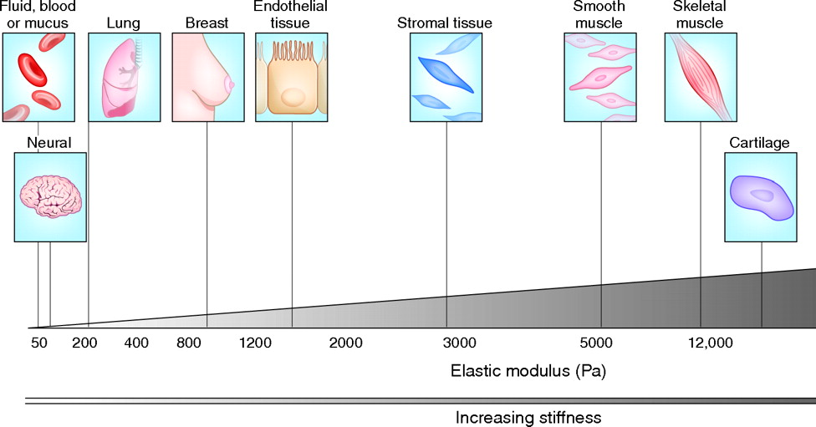
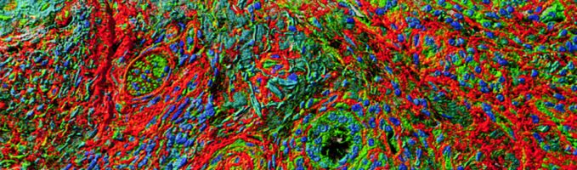
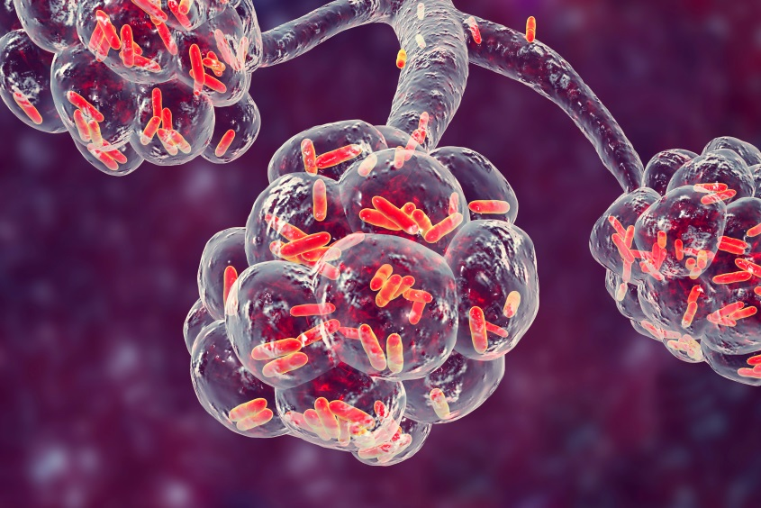
Restoring tissue physiology to limit “inflammatory” disease
Inflamed tissues or trapped inflammatory cells?
Do our lungs become more stromal as we age
Is there a good and bad placental environment – training pre-birth.

Slide 23




Thanks to:
Lab members:
Dr Sylvia Liu
Dr Dave Morgan
Dr Emma Connolly
Dr Anu Goenka
Dr Ben Mulhearn
Dr Chris Jagger
Jakub Chudziak
Dr Christine Chew
Dr Oliver Bland
Mirium Franklin
Sarah Warbach
Past members:
Dr Alek Grabiec
Dr Naoya Fujino
Dr Toshifumi Fujimori
Dr Tom Bell
Dr Manminder Kaur
Dr Samira Salek-Ardakani
Dr Mark Fife
Dr Lauren Cholewa
Dr Maryam Habibzay
Dr Alexandra Godlee
Dr John Goulding
Dr Robert Sanders
Dr Robert Snelgrove
Clinical colleagues:
Professor Angela Simpson
Professor Stephen Fowler
Professor Rob Niven
Professor Jurgen Vestbo

