Slide 1

Edinburgh 1-2 October 2018
Immunopharmacology : Challenges, opportunities and research tools
Inhibit activation or activate
inhibition of Mast Cells and Eosinophils: which weapon is better to fight allergic diseases?
Francesca Levi-Schaffer
School of Pharmacy and Institute of Drug Research
The Hebrew University Medical School
Jerusalem, Israel

Slide 2

Mast Cells, Eosinophils and Diseases
In ALLERGY (but also in several other diseases with different ethiopathogenesis) MAST CELLS are associated with EOSINOPHILS
Two unmet clinical needs: severe asthma and atopic dermatitis
Our GOAL is to determine new immunopharmacological targets for the treatment of allergic diseases. This by focusing on the two main effector cells of allergic inflammation i.e.the mast cells (MCs), the allergy” primum movens “ , and the eosinophils (Eos) the most common MC “companions”, and their allergic effector unit (MCs/Eos interactions)
Notes:
In allergy we have 2 main evidences . Mast cells are associated with eos and we have 2 unmet clinical needs . Our goal..
<number>

Slide 3

Our Oversimplified View of the Allergic Inflammatory Reaction
The “Allergic Effector Unit”
Basophil
Allergen
APC
CD48
2B4
CD48
Eosinophil
Bacteria
Viruses
CD4⁺ T cell
T Reg
Endothelial
cells
ILC2
Th2 cell
Smooth muscle cells
Fibroblasts/MyoFB
Epithelial cells
Chronic phase
B cell
Late phase
IgE
Mast cell
Acute-Early phase
Mast cells precursors
Inflammation,
Angiogenesis, tissue remodeling, fibrosis
-------------------------------------Time------------------------------- →
Notes:
<number>
<number>
<number>
<number>
This is an oversimplified view of AI a 3 stages process in which many immune and structural cells are involved .what is important for my lecture is that we put at the center of this universe the mcs and the eos the effector cells of allergy since their activation causes the symptoms of the disease and their interactions that we have during the years identified

Slide 4
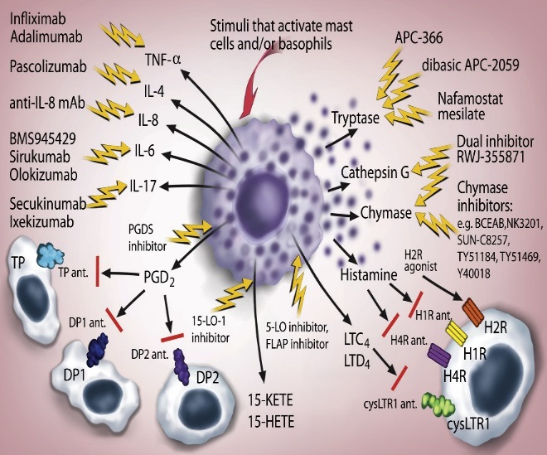
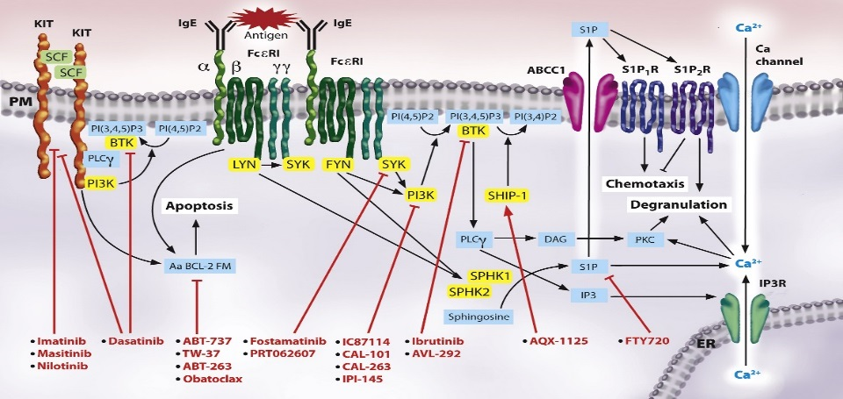
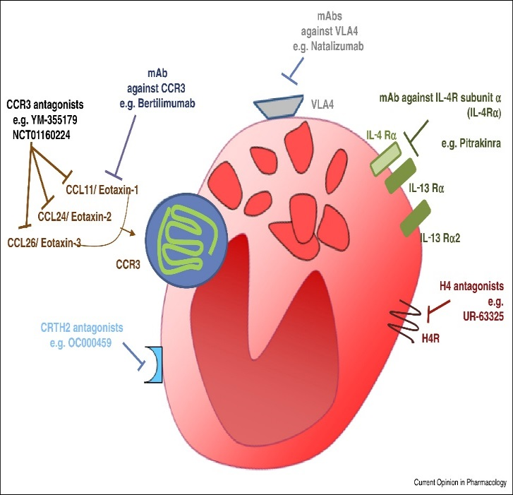
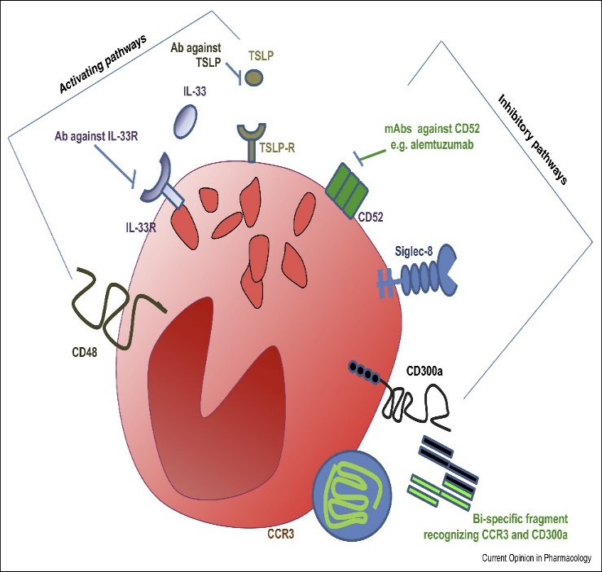
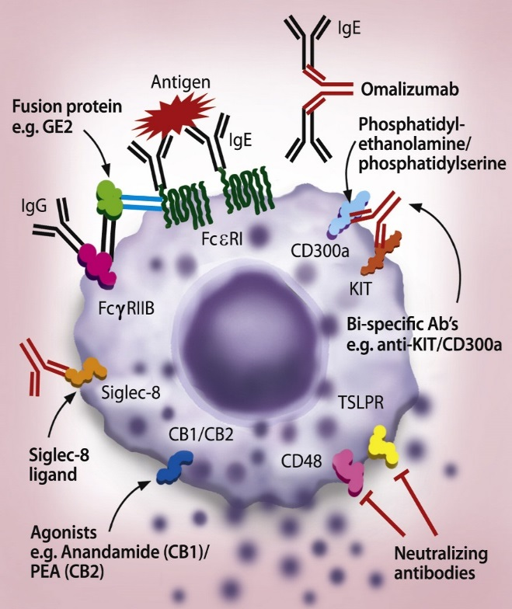

MC and Eos Soluble and Cellular Targets for Novel Anti-Allergic Therapy
Siglec-7
Siglec-7
Siglec-7
Siglec-8
Harvima IT et al., J Allergy Clin Immunol 2014
Landolina N et al., Curr Opin Pharm 2014
Gangwar RS et al. Pharmacol Ther. 2017
Bulfone-Paus S et al ,Trends Immunol 2017
Notes:
There is a big run to define new targets for therapy and this slide show some examples centering on mcs and eos. for example strategies to stop eotaxin , syk , IgE
<number>

Slide 5
1. Human MCs express the functional activating receptors CD48, DNAM-1 and PAR-2. And the death receptor TRAIL
2. Human Eos express the functional activating receptors CD48, 2B4 and Nectin-2.
3. MCs and Eos have a soluble and physical cross-talk :the Allergic Effector Unit (AEU).
4. Both human MCs and Eos express the functional inhibitory receptors CD300a and Siglec-7.
5. The activity of the pro-resolving lipid mediators (SPMs) LXB4 and LXA4 on MCs and Eos and in mice models of allergic inflammation.
Our findings in mast cell and eosinophil allergy related research

Slide 6
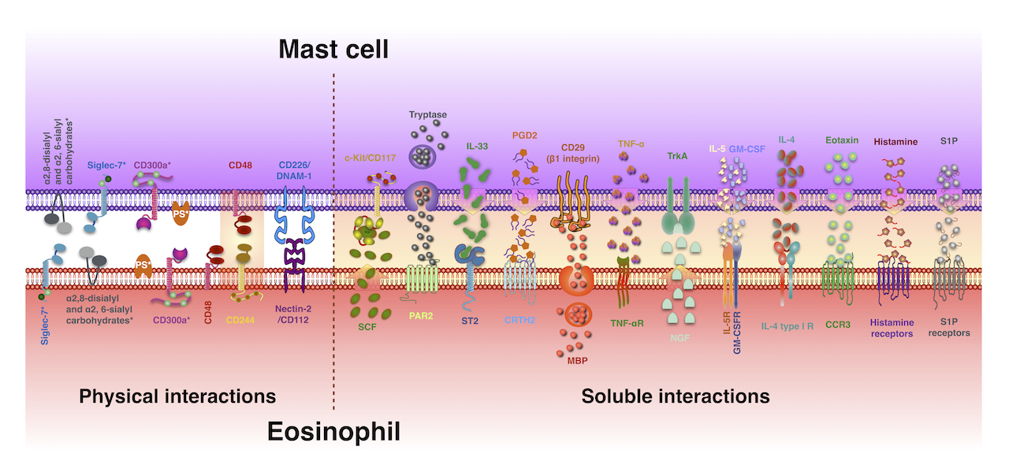
The Allergic Effector Unit (AEU):
a Strong Pro-inflammatory Cross-talk
Gangwar RS, Landolina N et. al., Pharm Ther 2016
Notes:
We studied receptors activating and inhbiting on mcs and eso hoping to find some druggable ones. And in this endavour we found some of them and their ligands on mcs and eos thus also being part of what we have defined the AEU. On the right side you see the soluble interactions that we and other colleagues have defined in the years and then what we have described based on physical contact I circled the ones we will talk about Increase cell survival and activation as we will see in the next slides
<number>

Slide 7
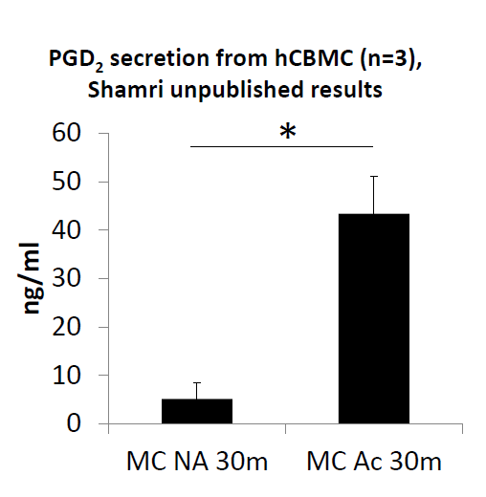
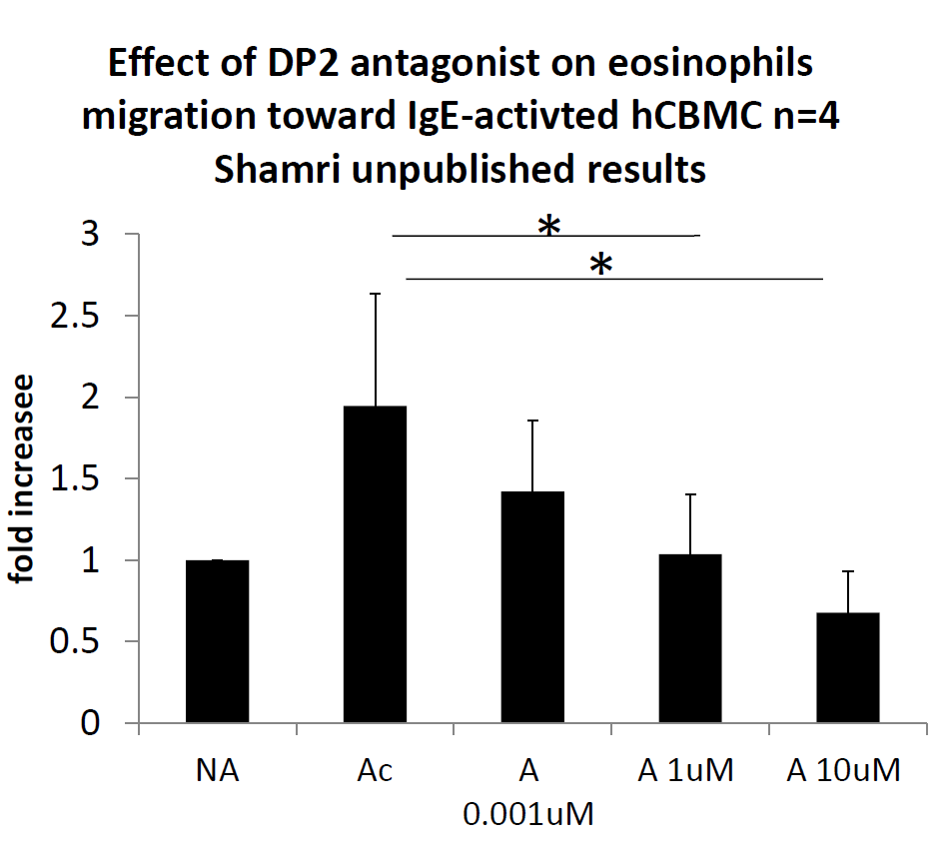
Mast cell derived PGD2 is a component of the AEU: Fevipiprant, a selective DP2 antagonist inhibits eosinophil chemotaxis towards IgE-activated mast cells
IgIG
IgE-activated CBMC release PGD2
Fevipiprant inhibits human eosinophil chemotaxis towards IgE-activated mast cells
Shamri T et al: under revision

Slide 8
Our Immunomodulatory Strategies
We aim to target receptors that are shared by MCs and Eos and that are important in the AEU
Activating receptors:
CD48 (MC and EOS)
Inhibitory receptors:
CD300a (MC and EOS)
Siglec-7 (MC and EOS)
Notes:
And they are CD48 and CD300a and Siglec-7

Slide 9
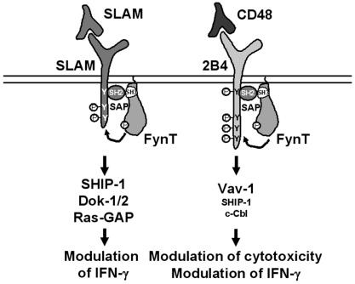
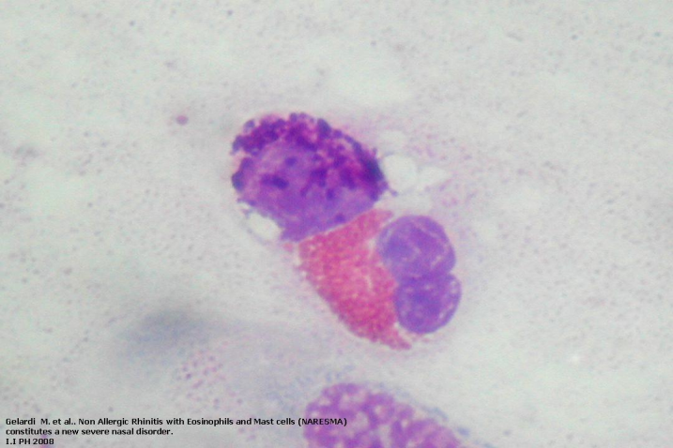
The Human AEU
CD48 and 2B4 (CD244) (CD2 family)
SLAM related
4 ITSM
High affinity ligand for CD48
NK and eosinophils activating receptor. Not expressed on human MCs
In the mouse on MCs and NKs it is an inhibitory receptor
Bacteria
Fungi
Viruses
GPI (glycosylphosphatidylinositol
Membrane bound form on leukocytes
Soluble form
Co-activating and activating receptor
High affinity ligand for 2B4
Allergens
CD48
2B4
Mast cell
Eosinophil
GPI
?
CD48
2B4
S. Aureus
and its exotoxins
Notes:
<number>
<number>
<number>
<number>
CD48 and its high affiinity ligand belong to the CD2 family

Slide 10
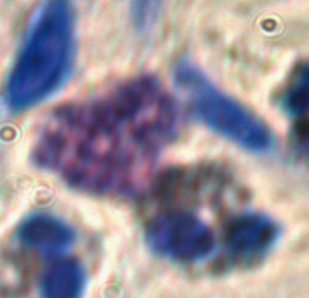
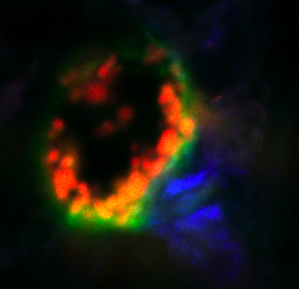
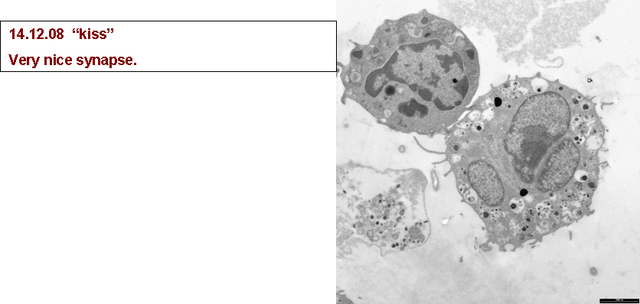
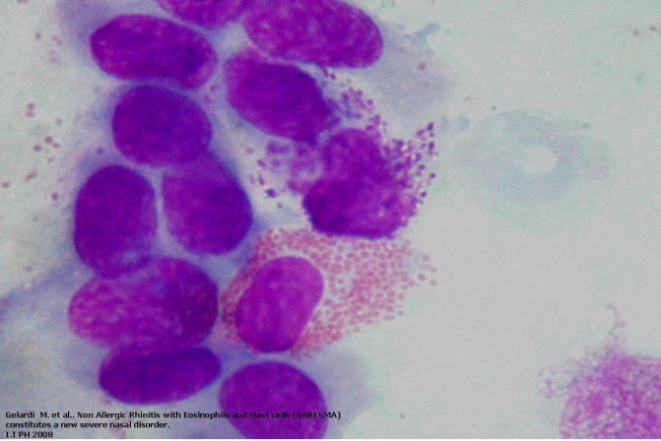
The Human AEU: Soluble and Physical Cross-talk
Physical contact
  Takes place in inflammatory
states.
  Occurs at significant rates.
  Is durable and stable.
  Partially involves 2B4 on Eos and -CD48 on MCs interactions.
Physical induced Cell Survival
  MC increase Eos survival.
  The effect requires both soluble and physical communication.
  GM-CSF is critical for the soluble effect, but is overridden by the physical contact.
  It involves 2B4-CD48 interactions.
  It is not inhibited by dexamethasone.
Physical induced Cell Activation
MC activation ( β-Hex release, tryptase) is induced by Eos via 2B4/CD48.
Eos activation (EPO release) is induced by MC but it is not via 2B4/CD48.
MC and Eos maintain an activated phenotype for up to 3 days :TNFα and IL-8 release; Syk and Lyn phosphorylation; activating receptors DNAM-1, Nectin2, LFA1 and CD49b expression stable and ICAM-1 on Eos is increased.
Elishmereni M and Levi-Schaffer F, Int J Biochem Cell Biol 2010
Minai-Fleminger Y, et al. Cell Tissue Res 2010
Elishmereni M et al, Allergy 2011
Elishmereni M et al, Allergy 2013
Elishmereni M et al ,JID 2014
Notes:
Here is the pivotal importnace of CD48 in the AEU
First I would like to introduce you at the importnace of CD48 in the AEU- all work from Moran and Yael
<number>

Slide 11
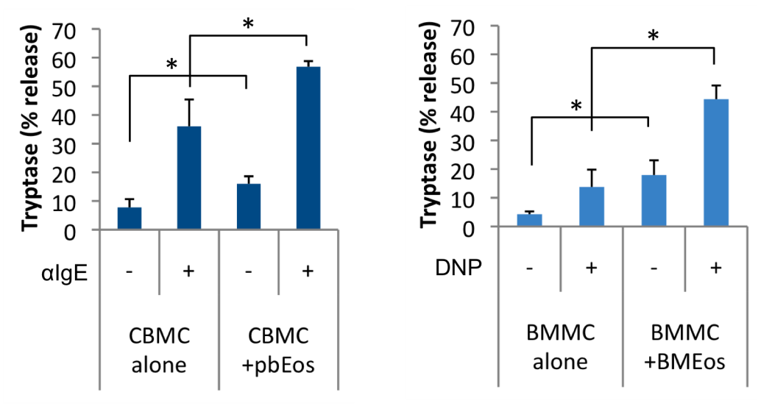
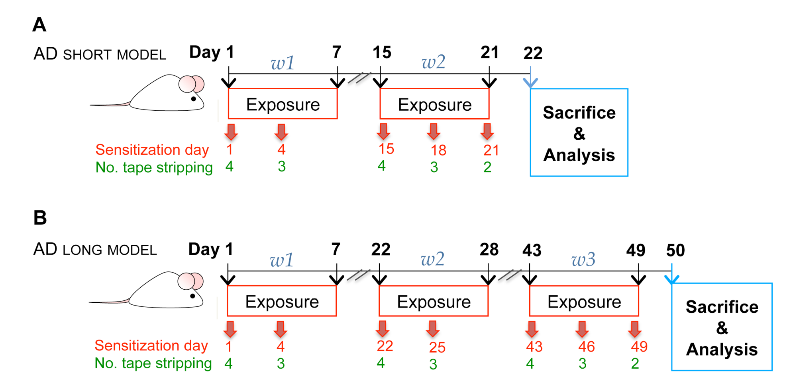
Murine Model of Atopic Dermatitis (AD)
Human MC:
Mouse MC:
The role of MCs, Eos, AEU and S. aureus
*
OVA/SEB
OVA/SEB
Elishmereni M et al, Allergy, 2013
Adapted from Wang.G et al,CEA 2007
Notes:
Human and mouse the same . So we investigated the importance of CD48 in mice in 2 models of AD. This also includes SEB?S aureus that we will see is important in allergy
<number>

Slide 12
Short Term AD in 2B4-/- Mice
Decreased inflammatory responses
p=0.08
Total MC
Total Eos
Dermis
Epidermis
*
p=0.1
p=0.08
**
p=0.08
*
p=0.09
Layer thickness (μm)
Degranulated MC
Cells/HPF
*
*
Total IgE
OVA IgE
TNFα
p=0.05
p=0.05
*
*
p=0.09
*
pg/ml
pg/ml
OD (405)
CPU( x1000)
Total cells in LN
**
*
CD3+
CD4+
CD8+
Foxp3+
*
*
**
**
*
p=0.08
*
Cells/HPF
Elishmereni M et al, JID 2014
Notes:
First we utilised 2B4 ko mice and detected that in absence of the CD48 ligand decreased inflammatory responses such as…
<number>

Slide 13

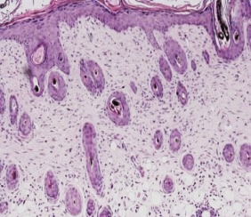
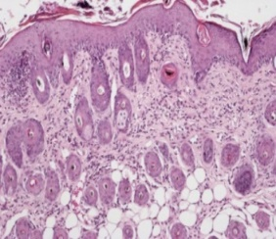
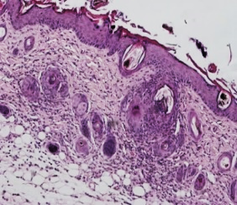
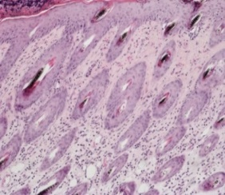
Short Term AD in CD48-/- Mice
Decreased skin inflammatory responses
WT PBS
WT SEB+OVA
CD48-/- PBS
CD48-/- SEB+OVA
IgE anti OVA serum levels
AEU
Gangwar, R.S, et al . unpublished data
Notes:
Importantly A similar trend in CD48 ko indicating that the CD48/2B4 pathway is an important target to downregulate AI
<number>

Slide 14
CD48 as Target for Anti-Allergy/Anti-Inflammation Intervention
“Inhibit Activation”
CD48 is one of the 291 mouse asthma signature-genes (Zimmerman N et al., JCI 2003).
Allergic lung inflammation is inhibited in mice treated with anti-CD48 blocking Abs.2B4 is an activating receptor on Eos: (Munitz A et al., J immunol 2005 and Am J Respir Crit Care Med 2007).
MC-CD48 is important in the pro-inflammatory AEU as ligand of Eos-2B4 (Elishmereni M et al.Allergy, 2011, 2014,J Invest Dermatol 2014).
Both MCs and Eos express CD48 that is a main player of their interaction with S.aureus (Rocha-de-Souza C. M. et al., Infect Immun 2008; Minai-Fleminger Y et al., Clin Exp allergy 2014; Gangwar RS and Levi-Schaffer, Allergy 2016).
The severity of AD in 2B4KO mice is reduced (Minai-Fleminger Y et al., Clin Exp allergy 2014; Elishmereni M et al., J Invest Dermatol 2014).
Eos associated CD48 is modulated by cell activation and gives rise to soluble CD48 (sCD48).sCD48 is a decoy receptor (in vitro and in vivo) (Gangwar RS and Levi-Schaffer F, Allergy 2016).
Human asthma: mCD48 and sCD48 are potential new biomarkers for the disease (Gangwar RS et al., Allergy 2017).
Is CD48 a biomarker for airway inflammation and non-allergic asthma? (Breuer O el al, J Immunol. Reserch, in press)
Notes:
Because of what I described until now and because of other published evidences that i am highlighting now we decided that the target should be CD48. Indeed gene, allergic lung inflammation, very importnatly S>aureus...SEB and ORMDL-3

Slide 15
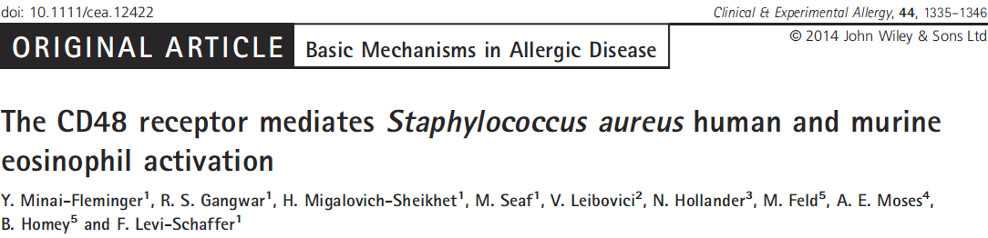
Importance of CD48: S.aureus-Eos
Eosinophil expression of CD48 is increased in the
presence of SA/ exotoxins.
CD48 mediates binding of SA/ exotoxins to eosinophils.
SA/exotoxins induce CD48 mediated Eos degranulation, cytokine release and phosphorylation of signal transduction molecules.
CD48 mediates Staphylococcal enterotoxin B (SEB) induced peritonitis in mice.

Slide 16
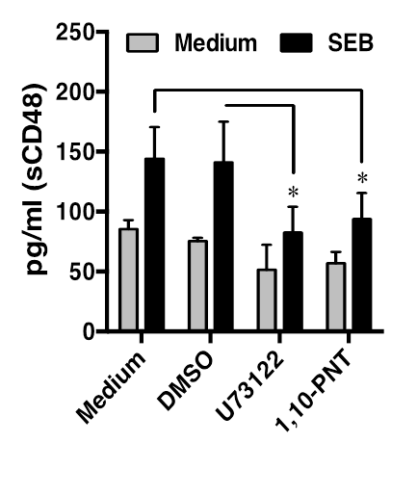
The Importance of CD48: S.aureus-Eos
SEB Regulates CD48 on Eos and sCD48 Formation via a Phospholipase Mechanism
Gangwar RS and Levi-Schaffer F, Allergy 2016
Notes:
Roopesh found that not only there is interaction between SEB and eos but SEB regulates CD48 expression and formation of a soluble form, sCD48 by phospholipase c and d
<number>

Slide 17
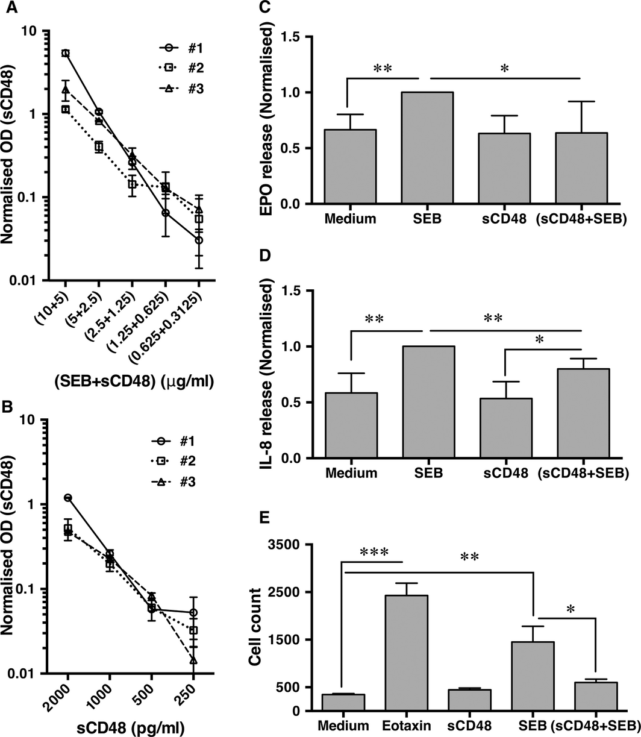
The Importance of CD48: S.aureus-Eos
sCD48 binds to SEB and acts as a decoy receptor on Eos
sCD48 binding with SEB
Anti-inflammatory effects of sCD48 in vitro
Gangwar RS and Levi-Schaffer F, Allergy 2016
Notes:
<number>
. sCD48 binding to SEB was examined by sandwich ELISA, Anti‐inflammatory effects of sCD48 in vitro

Slide 18
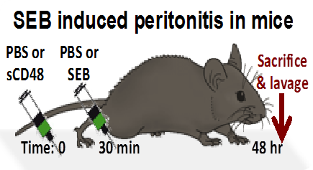
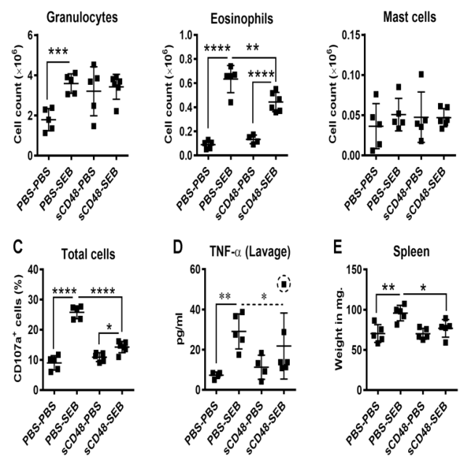
The Importance of CD48: S.aureus-Eos
sCD48 is anti-inflammatory in SEB induced peritonitis
n=3. *, p<0.05. **, p<0.01. ***, p<0.001 and ****, p<0.0001.
Gangwar RS and Levi-Schaffer F, Allergy 2016
Notes:
sCD48 is antiinflammatory in vivo
<number>

Slide 19
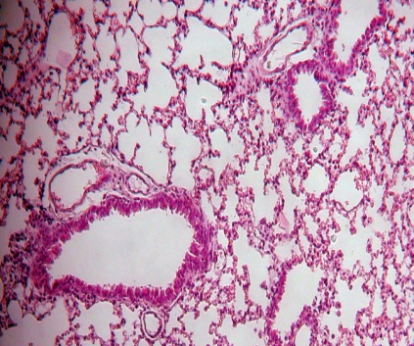
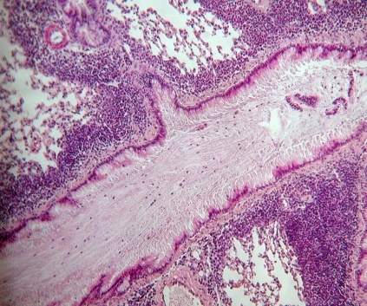
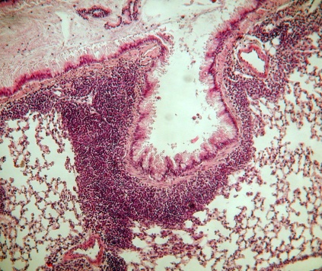
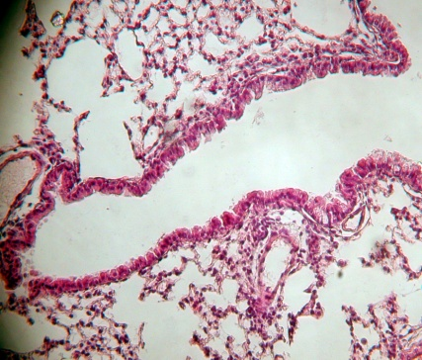
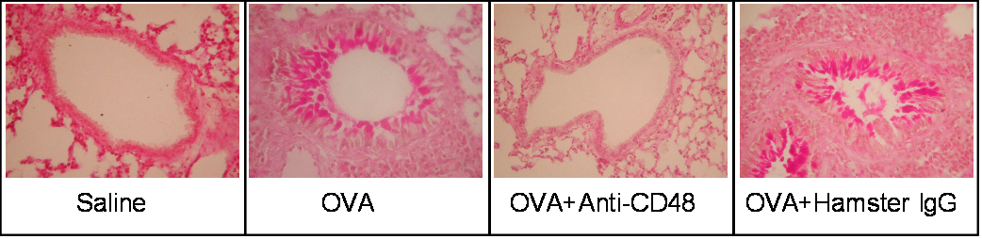
Neutralization of CD48 Inhibits Mouse Asthma
Saline
OVA
Hamster IgG
Anti-CD48
Decrease of eosinophilia, cytokine and chemokine production
Munitz et al Am J Respir Crit Care Med. 2007

Slide 20
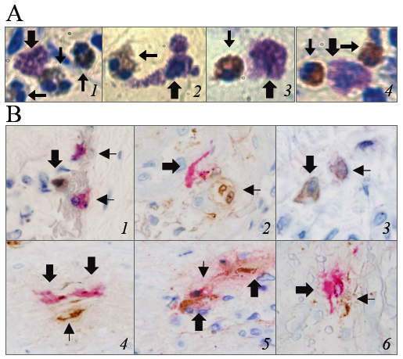
Human Asthma, Human Atopic Dermatitis the AEU and CD48
Elishmereni M et al, Allergy 2013; Gangwar R et al, Allergy 2017
Notes:
Now we move to human asthma the aeu CD48
<number>

Slide 21
mCD48 is Differentially Expressed on Blood Leukocytes of Asthma Patients with Varying Severity
Gangwar RS et al. Allergy 2017
Notes:
mCD48 is differentially expressed on blood leukocytes of asthma patients with varying severity. mCD48 expression on peripheral blood leukocytes from asthmatic patients and controls identified by staining with their specific cell surface markers. Data are shown as the MFI median (IQR) * p<0.05; **** p<0.0001.
<number>

Slide 22
sCD48 is Elevated in Serum of Mild Asthma and Decreased in Moderate and Severe Asthma
Prediction of a Cut-off Value of sCD48 for Segregation between Asthma (Mild, Steroid Naive) and Health
No correlation was found between sCD48 and atopy, IgE levels, Eos numbers and percentages, gender, age, smoking, BMI
Gangwar RS et al. Allergy 2017
Notes:
sCD48 is elevated in serum of mild asthma while it is decreased in moderate and severe asthma. sCD48 levels in the sera from (A) IL cohort and (B-C) UK cohort. The patients were subcategorized based on the use of corticosteroids (±ICS and/or oral CS), in (C). Data are shown as the median (IQR). * p<0.05; ** p< 0.01; **** p<0.0001.
<number>

Slide 23
Is CD48 a New Independent Biomarker for Airway Inflammation and Non-allergic Asthma?
sCD48 in volunteers with asthma and control (A); sCD48 (B), cytokines (C-F), IgE (G) and absolute eosinophil numbers (H) in volunteers with allergic asthma, non-allergic asthma and control.
*P < 0.05, **P < 0.01,***P < 0.001, ****P < 0.0001. Abs – absolute, Eos - eosinophil
Breuer O et al, J Immunol Research, in press

Slide 24

“Our” Inhibitory Receptors
CD300a
Siglec7
Ig anchor
cysteins
V-Type
Ig domain
V
C
C
C2
L
C2
H
Y
A
N
L
I
ITIM
V
V
E
S
Y
Y
S
D
T
S
V
L
H
Y
A
S
V
It belongs to the Ig superfamily
3 classical and one non classical ITIMs
Expressed on NK cells, neutrophils, T and B lymphocytes, mast cells, eosinophils, basophils. Expressed on malignant cells
CD300a recognizes phosphatidyl serine (PS) and phosphatidylethanolamine (PE) on apoptotic cells
It belongs to the Ig superfamily
1 classical ITIM and 1 ITIM like
Expressed on NK cells, monocytes, subset of CD8 T cells, mast cells, eosinophils, basophils. Expressed on malignant cells
Siglec-7 recognizes sugars with sialic acid N-acetylneuraminic acid (Neu5Ac)
Levi-Schaffer, Mandelboim, Trends Immunol 2017, Inhibitory and Coactivating Receptors Recognising the Same Ligand: Immune Homeostasis Exploited by Pathogens and Tumours.
Notes:
Now the IR story. Both receptors first described by moretta’s group on NK cells
<number>

Slide 25
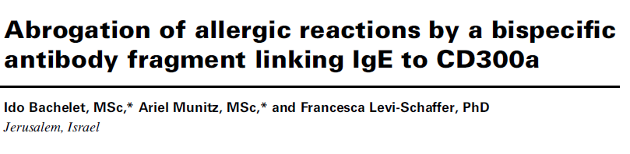

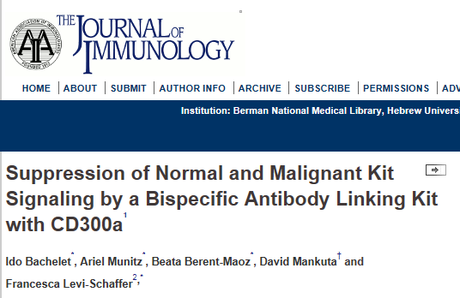
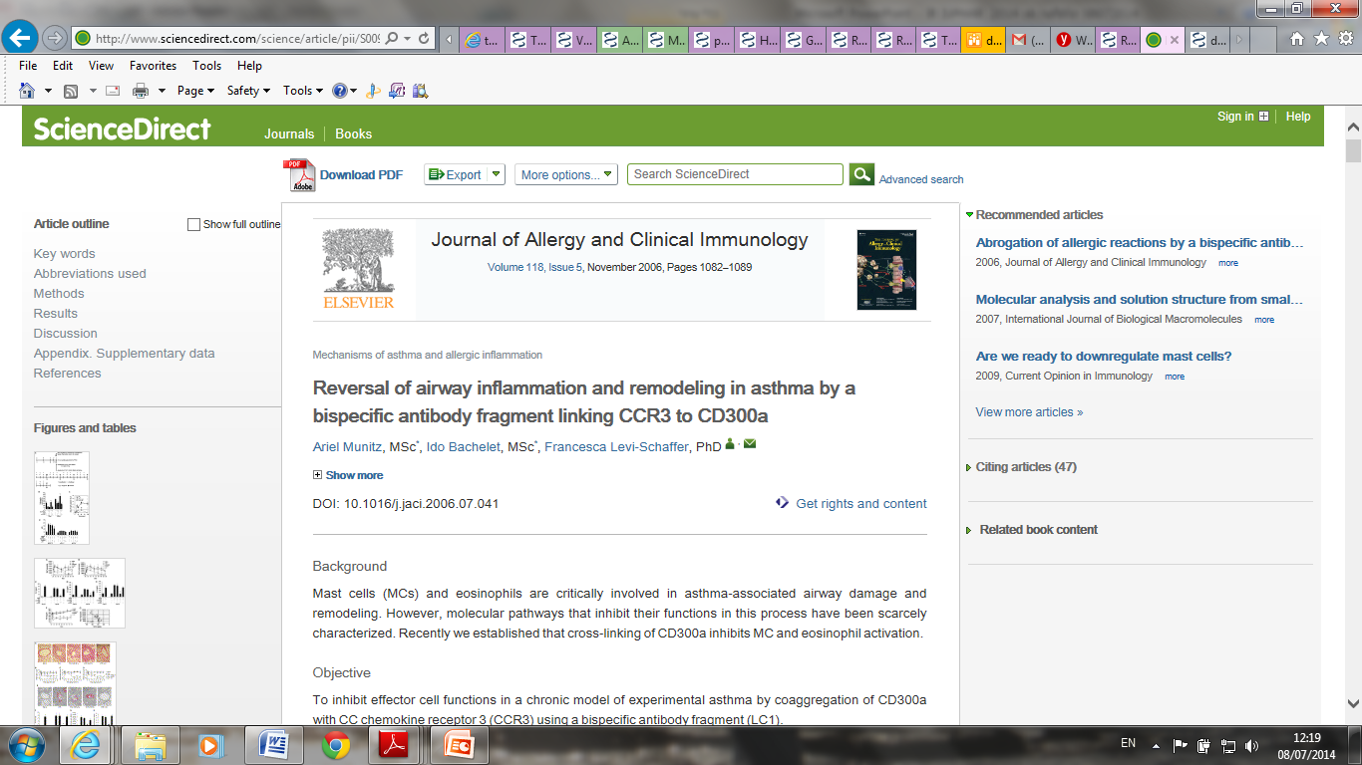
Karra et al , Submitted "CD300a expression and role in atopic dermatitis"
IgE
Bispecific antibody fragment
CCR3
c-Kit
CD300a
Ben Efraim et al., Allergy 2013 The inhibitory receptor CD300a is up-regulated by hypoxia and GM-CSF in human peripheral blood eosinophils.
FceRI
Notes:
<number>
<number>

Slide 26
CD300a expression is differentially increased in the lesional skin of AD patients.
Karra L et al ,under revision
Notes:
(A) Immunofluorescence analysis of CD300a expression in AD lesional skin (AD skin) and normal skin (NS) sections. (B) Numbers of total CD300a⁺ cells. (C) Differential cell count of eosinophils (Eos), mast cells (MCs), dermal dendritic cells (DDCs), epidermal dendritic cells (EDCs), natural killer cells (NK) and macrophages (MΦ). (D) CD300a expression on the aforementioned cell types. (E) Immunofluorescence picture of CD300a as expressed by MCs and Eos. Data are the mean ± SEM, n=6-9 samples, *p<0.05, **p<0.01, ***p<0.001, ****p<0.0001.
<number>

Slide 27
Skin thickness and inflammation are modulated in an AD model in CD300a^{-/-} mice
Karra L et al ,under revision
Notes:
.
(A) Representative histological H&E images of skin from WT and CD300a^{-/-} following OVA/SEB or PBS exposure. (B-C) Epidermal (B) and dermal (C) skin thickness; (D-F) Eos (D), Intact (E) and degranulated (F) MCs and numbers; (G-K) Relative expression levels of IL-4 (G), IL-5 (H), IL-13 (I), IL-17A (J) and IFN-γ (K) mRNA in skin of WT and CD300a^{-/-} mice following challenge with PBS or OVA/SEB. Data are the mean ±SEM, n=5 mice/group, *p<0.05, **p<0.01, ***p<0.001, ****p<0.0001. One way-ANOVA analysis was performed. CONCLUSIONS
CD300a expression is modulated in atopic dermatitis and could influence the inflammatory responses
<number>

Slide 28
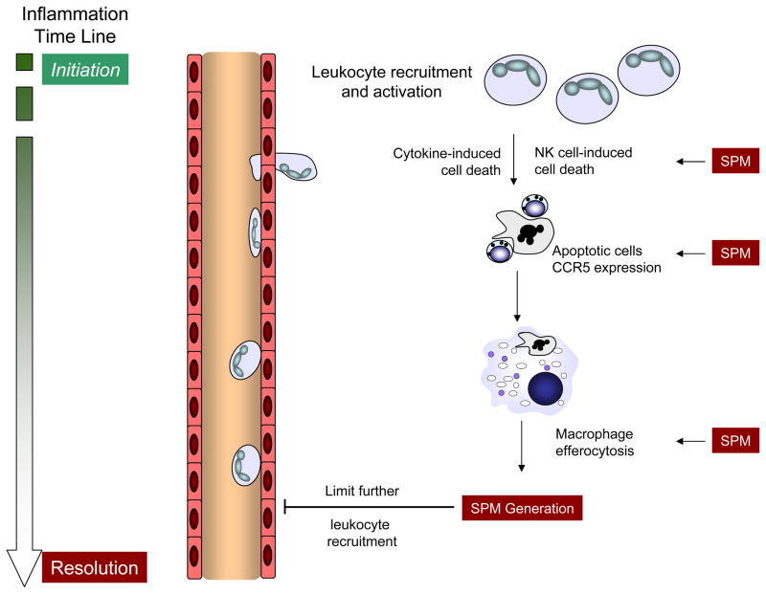
SPM promote the resolution of tissue inflammation and limit further leukocyte recruitment
Levy & Serhan, Annu Rev Physiol, 2014
Are both CD300a and SPMs involved in resolution of allergic peritonitis ?
Notes:
With the initiation of acute inflammation, circulating leukocytes are recruited from the microcirculation to tissues to respond to an invading pathogen, organ injury or a noxious stimulus. To prevent excess inflammation and collateral injury of healthy tissue, there are several mechanisms to restrain the inflammatory response, some of which are illustrated here. With source control, neutrophils (cytokine- or NK cell-induced) and T-cells (activation-induced) undergo apoptosis. SPM increase apoptotic leukocyte expression of CCR5 that serves an important pro-resolving role as a chemokine scavenger. Macrophage efferocytosis of CCR5-expressing apoptotic leukocytes effectively clears the cellular debris and pro-inflammatory chemokines and concomitantly initiates the generation of SPM that also limit further leukocyte recruitment, activation and maturation. These cellular events are pivotal to the termination of acute inflammation.
<number>

Slide 29
CD300a expression on peritoneal cells is modulated in an AP model
Karra L. et al , Journal of Immunology: in press
Notes:
(A) Schematic representation of the murine AP model. (B) FACS analysis of CD300a expression on peritoneal cells at different times after OVA challenge. 72hrs after OVA challenge: (C) CD300a⁺ total peritoneal cell population. (D) CD300a expression on peritoneal granulocytes, monocytes and lymphocytes. (E) CD300a expression on Eos, MCs and MΦ. (F-G) MFI levels of CD300a on Siglec-F⁺ (F) and Siglec-F⁻ cells (G). Data are presented as mean ± SEM (n=5-6 mice per group) *p<0.05; ***p<0.001; ****p<0.0001
<number>

Slide 30
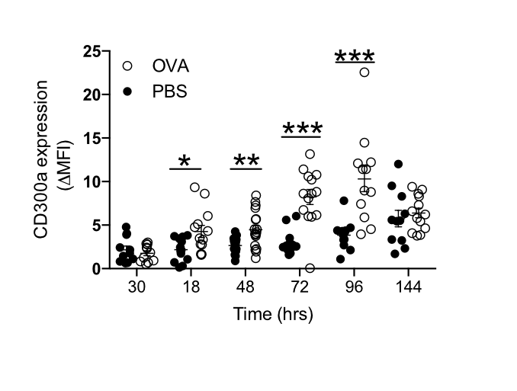
CD300a increased expression on peritoneal cells is allergen challenge-specific
Karra L. et al , Journal of Immunology: in press
Notes:
FACS analysis of CD300a expression on peritoneal cells at different times after PBS and OVA challenge.
<number>

Slide 31
CD300a^{-/-} mice present a delayed resolution of inflammation in the AP model
Karra L. et al , Journal of Immunology: in press
Notes:
Total peritoneal cells (A), MCs (B) and Eos numbers (C), n=10-19 mice per group, */#p<0.05. # represents statistical significance between WT and CD300a^{-/-} mice at the indicated time point. Data are presented as mean ± SEM. (D-E) Resolution interval (Ri) of MCs (D) and Eos (E), calculated using the mean number of 50% of each cell population number 96 hrs post-challenge.
<number>

Slide 32
ALX/FPR2 is differentially regulated in CD300a^{-/-}
and WT mice
Karra L. et al , Journal of Immunology: in press
Notes:
Kinetics of ALX/FPR2 expression on total peritoneal cells (A), on monocytes (B), granulocytes (C) and lymphocytes (D) following OVA challenge in WT and CD300a^{-/-} mice, n=7-13 mice per group, */#p<0.05, **/## p< 0.01, ***/###p<0.001, ****/####p< 0.0001. # represents differences between WT and CD300a^{-/-} mice at the indicated time point.
Data are presented as mean ± SEM, n=7-13 mice per group.
<number>

Slide 33
ALX/FPR2 is down-regulated on Eos while LXA₄ is increased in the peritoneum
of CD300a^{-/-} mice in the AP model
CD300a -/-,48 hrs AP
Karra L. et al , Journal of Immunology: in press
Notes:
ALX/FPR2 expression and ALX/FPR2 MFI levels on peritoneal MCs (A), Eos (B) and MΦ (C) 48 hrs following antigen challenge in WT and CD300a^{-/-} mice. Red histogram-isotype control; blue histogram ALX/FPR2. Data are presented as mean ± SEM, n=5, *p<0.05. (D-F) Quantitative expression of ALX/FPR2 on MCs (D), Eos (E) and MΦ (F) of WT and CD300a^{-/-} mice. Data are presented as mean ± SEM, n=5 mice per group, *p<0.05. (G) Kinetics of LXA₄ levels [pg/ml] measured in the peritoneal lavages of OVA-challenged WT and CD300a^{-/-} mice. Data are presented as mean ± SEM of n=6-15 mice per group, */#p<0.05, ***p<0.001, ****p< 0.0001. # represents differences between WT and CD300a^{-/-} mice at the indicated time point.
<number>

Slide 34
CD300a activation modulates ALX/FPR2 expression on BMMC
Karra L. et al , Journal of Immunology: in press
Notes:
(A) Normalized ALX/FPR2 MFI levels on IgE-anti-DNP sensitized BMMCs obtained from WT and CD300a^{-/-} mice 30 min after DNP-BSA challenge. Data are presented as mean ± SEM (n=7-13 mice per group), *p<0.05. (B) Representative histogram of ALX/FPR2 levels on WT IgE-sensitized BMMCs following incubation with anti-CD300a and with anti-rat (Fab’)2 (Activated + αCD300a), or following incubation with isotype control (rat IgG2a) and with anti-rat (Fab’)2 (Activated + IgG2a). WT BMMC incubated in buffer only (Non-activated) were used as an additional control, n=3, p<0.05.
<number>

Slide 35
AP spatiotemporal expression of mast cell and eosinophil associated CD300a and ALX/FPR2, and LXA₄ production.
Conclusion :Leukocyte CD300a contributes to the resolution of murine allergic inflammation
Karra L. et al , Journal of Immunology: in press
Notes:
Representation of the time course of expression of CD300a, ALX/FPR2 and LXA₄ on mast cells (MCs) and eosinophils (Eos) in in the peritoneal lavage of WT (upper panel) and CD300a^{-/-} (lower panel) mice. During the onset of AP, ALX/FPR2 expression is significantly higher in WT mice, especially on MCs, while CD300a expression starts to increase on both MCs and Eos. LXA₄ in peritoneal lavages shows no differences between WT and CD300a^{-/-} mice. At the peak of inflammation, in both WT and CD300a^{-/-} mice Eos numbers increase together with CD300a expression. Moreover, in both WT and CD300a^{-/-} mice ALX/FPR2 expression decreases, while LXA₄ production is significantly increased and CD300a^{-/-} mice show more LXA₄ than WT. In the resolution phase, the system returns to the original conditions in WT mice, while CD300a^{-/-} mice still present higher numbers of Eos.
<number>

Slide 36
Summary
We have demonstrated the important role of the MC and Eos shared receptors CD48 and CD300a.
Conclusions
Allergic inflammation and other diseases in which mast cells and eosinophils have a role can be down-regulated by immunopharmacological modulation of these cells either by inhibiting the activating receptor CD48 or by activating the inhibitory receptors CD300a (and Siglec-7).
What is the best strategy in the allergic patients? To personalize the treatment. For a subgroup of patients who display high CD48 expression and do not respond optimally to any of the currently available therapies, to block CD48. For all the subtypes of patients who display CD300a or Siglec-7 to activate these receptors.

Slide 37
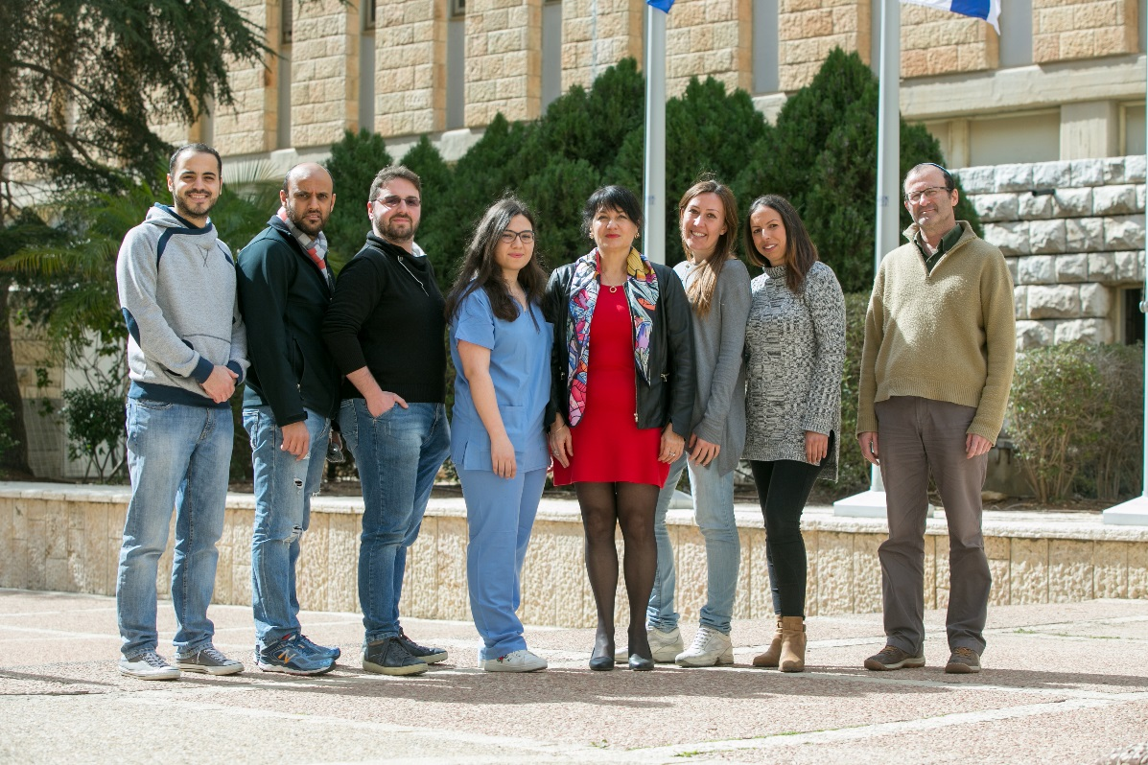
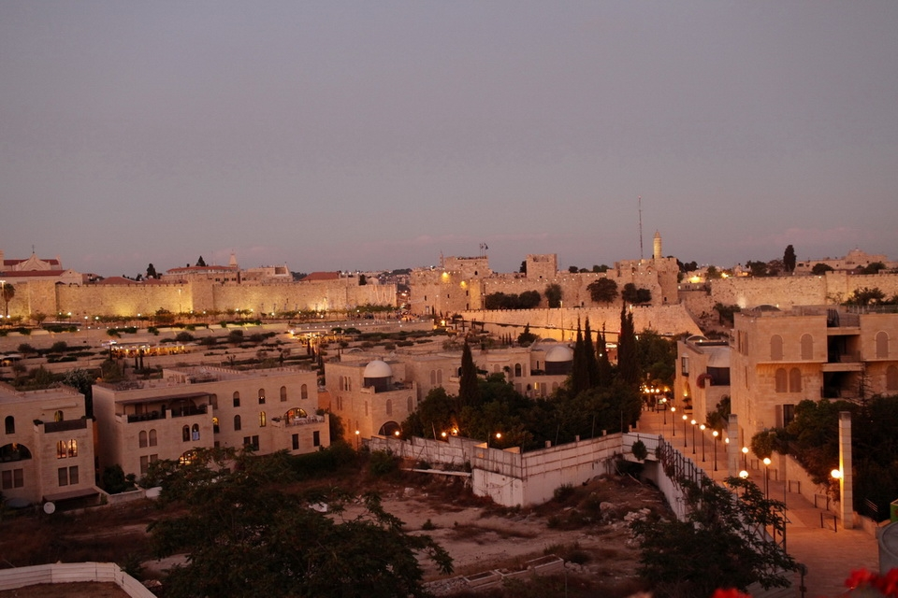
Thanks !
Francesca Levi-Schaffer ‘s group
Micha Ben Zimra
Nadine Landolina
Hadas Pahima
Pier Giorgio Puzzovio
Mansour Seaf
Ilan Zaffran
Yaara Zoabi
Research grants: ISF (Israel Academy of Science), BSF (United States-Israel Binational Science Foundation), Aimwell Trust Foundation, A Gutmann Funds, Rosetrees Trust

Slide 38
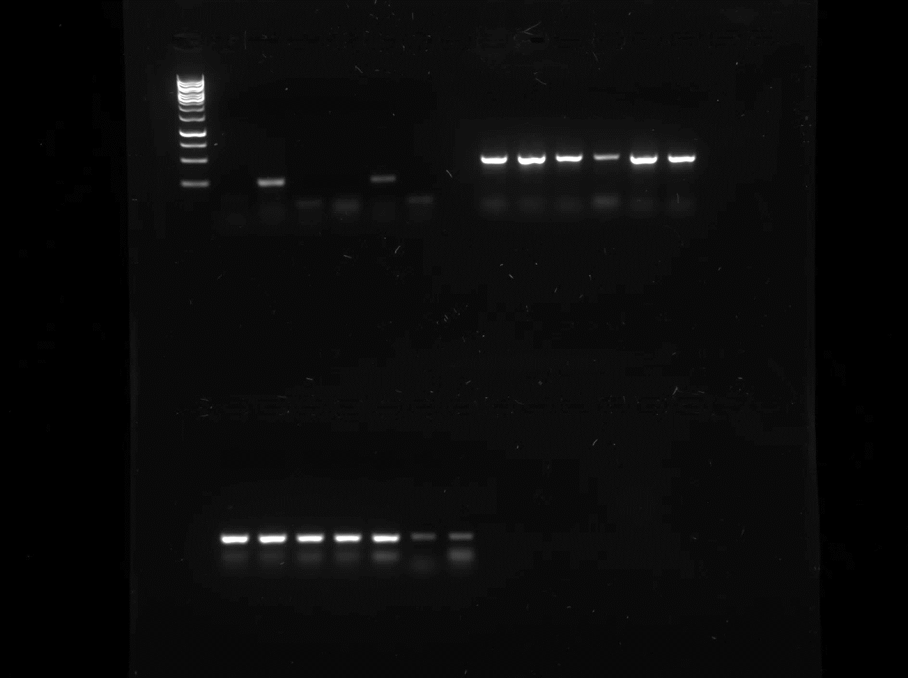
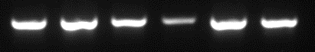
Macrophages from peritoneal lavage of WT and CD300a KO Balb/c, AP 48 hrs, Expression of iNOS and Arg1
WT OVA
CD300a KO OVA
LPS 1ug/ml
-
+
-
-
+
-
IL-4 10 ng/ml
-
-
+
-
-
+
iNOS
Arg1
β-actin
iNOS (marker for M1 Macrophages) mRNA appears only after treatment with LPS, but is reduced in CD300a KO macrophages. LPS is commonly used as inducer of M1 phenotype.
Arg1 (marker for M2 macrophages) mRNA is reduced in CD300a untreated macrophages (marked in red squares). IL-4 is used as inducer of M2 phenotype.
Puzzovio PG, Levi-Schaffer F, Unpublished results
Notes:
Macrophages were purified by plating peritoneal lavages, letting cells adhere for 2 hrs at 37°C. Then, three washes with warm PBS were performed to remove non adherent cells and RPMI + 10% FBS was added in the wells. After o.n. culturing, treatments were added to cells. After 18 hrs, supernatants were collected for cytokine release assay and cells harvested for mRNA extraction.
<number>

Slide 39
Macrophages from peritoneal lavage of WT and CD300a KO Balb/c, AP 48 hrs, IL-6 release
A
CD300a KO macrophages show significant increase in IL-6 production in respect to WT
Significant increases occur in IL-6 release after treament with LPS and IL-4
Puzzovio PG, Levi-Schaffer F, Unpublished results

Slide 40
Macrophages from peritoneal lavage of WT and CD300a KO Balb/c, AP 48 hrs, IL-10 release
B
CD300a KO macrophages have no significant change in IL-10 release in respect to WT (maybe because of the early time point?).
After treatment with LPS or IL-4, IL-10 release increases significantly in CD300a KO macrophages.
Puzzovio PG, Levi-Schaffer F, Unpublished results

Slide 41
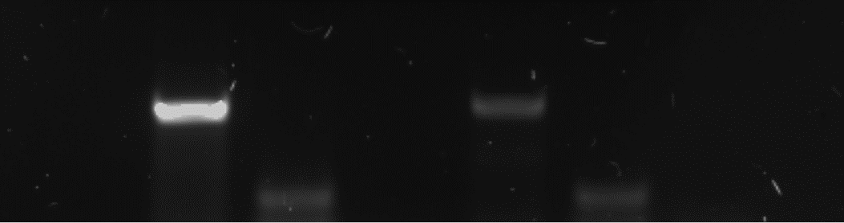
Macrophages from peritoneal lavage of WT and CD300a KO Balb/c, AP 96 hrs, Expression of iNOS and Arg1
WT OVA
CD300a KO OVA
iNOS
Arg1
β-actin
Puzzovio PG, Levi-Schaffer F, Unpublished results

Slide 42
Macrophages from peritoneal lavage of WT and CD300a KO Balb/c, AP 96 hrs, cytokines release
A
B
C
Puzzovio PG, Levi-Schaffer F, Unpublished results

Slide 43


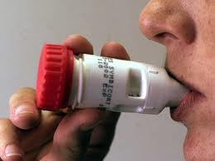
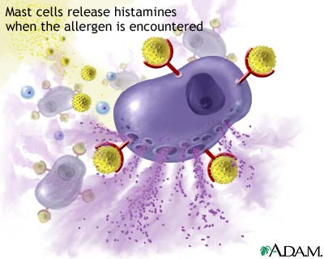
Allergies? Lets stop it!
Lab searching for a motivated Ph.D./M.Sc. Student
for a challenging project in the field of Allergy and targeted
Antibody-mediated therapy.
Project interests:
1. Mechanisms underlying the
pathophysiology of skin and airways allergic diseases
(Atopic dermatitis and asthma)
(2. Resoultion processes of Allergic inflammation
Lab work includes Immunological, molecular biology
and biochemical methods, as well as in vivo models in mice.
For more information please contact:
Professor Francesca Levi-Schaffer,
Pharmacology and Experimental Therapeutics
Faculty of Medicine
The Hebrew University ,Jerusalem, Israel
02-6757512
Email: francescal@ekmd.huji.ac.il
Anti-histamines?

Slide 44
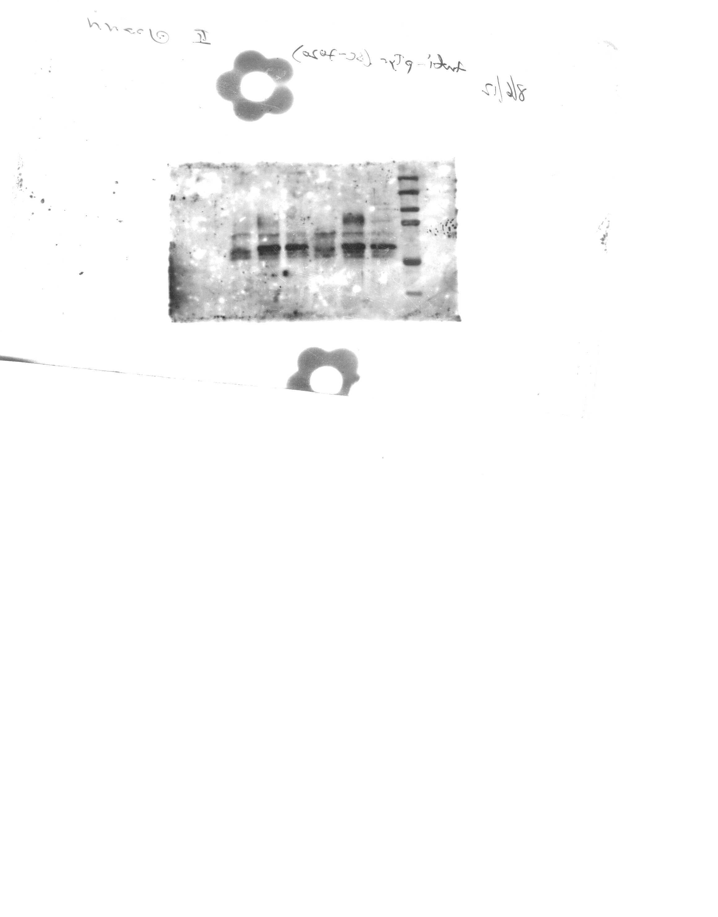
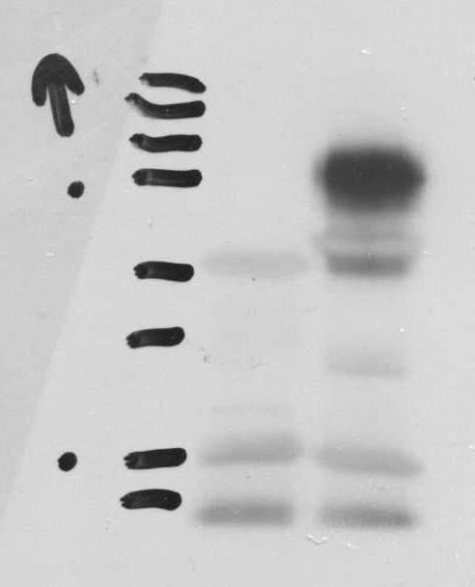
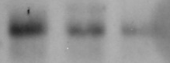
Siglec-7 is Expressed and Functional on Human Mast Cells
Orthovanadate 1mM :
CBMC
Foreskin
MC
HMC-1.1
HMC-1.2
LAD2
IP:
CBMC
LAD-2
HMC1.1
Siglec-7
Siglec-7
+
+
WB:p-Tyr
75kDa
WB:p-SHP-1
IP:
mIgG₁
αSig-7
WB:
goat αSig-7
Siglec-7 activation inhibits normal human mast cell activation (Tryptase, PGD2/GM-CSF)
Siglec-7 activation inhibits MC leukemic LAD-2 cell activation
P<0.001
*
*
Tryptase release (%)
β-Hexosaminidas release (%)
10
-
-
-
10
0.2
-
-
10
0.2
1
-
10
0.2
0.2
-
10
0.2
0.04
-
10
0.2
-
1
10
0.2
-
0.2
10
0.2
-
0.04
-
-
-
-
10
-
-
-
10
0.25
-
10
0.25
1
10
0.25
0.2
10
0.2
5
0.04
10
0.25
-
10
0.25
-
10
0.25
-
0.04
co-cross-linker F(ab’)₂
mouse anti-human IgE
mIgG1
anti-Siglec-7
Mizrahi S et al., J Allergy Clin Immunol. 2014
Siglec-7 is expressed on peripheral blood and nasal polyp eosinophils
Munitz A et al., Blood 2006
Siglec-7 is Expressed on Human Eosinophils and its activation by specific mAbs Inhibits their activation
Landolina N, Legrand F , Klion A and Levi-Schaffer F, unpublished data
Notes:
A new different target is Siglec-7. here we show its potency in downregualting MC activation eos too
<number>

Slide 45
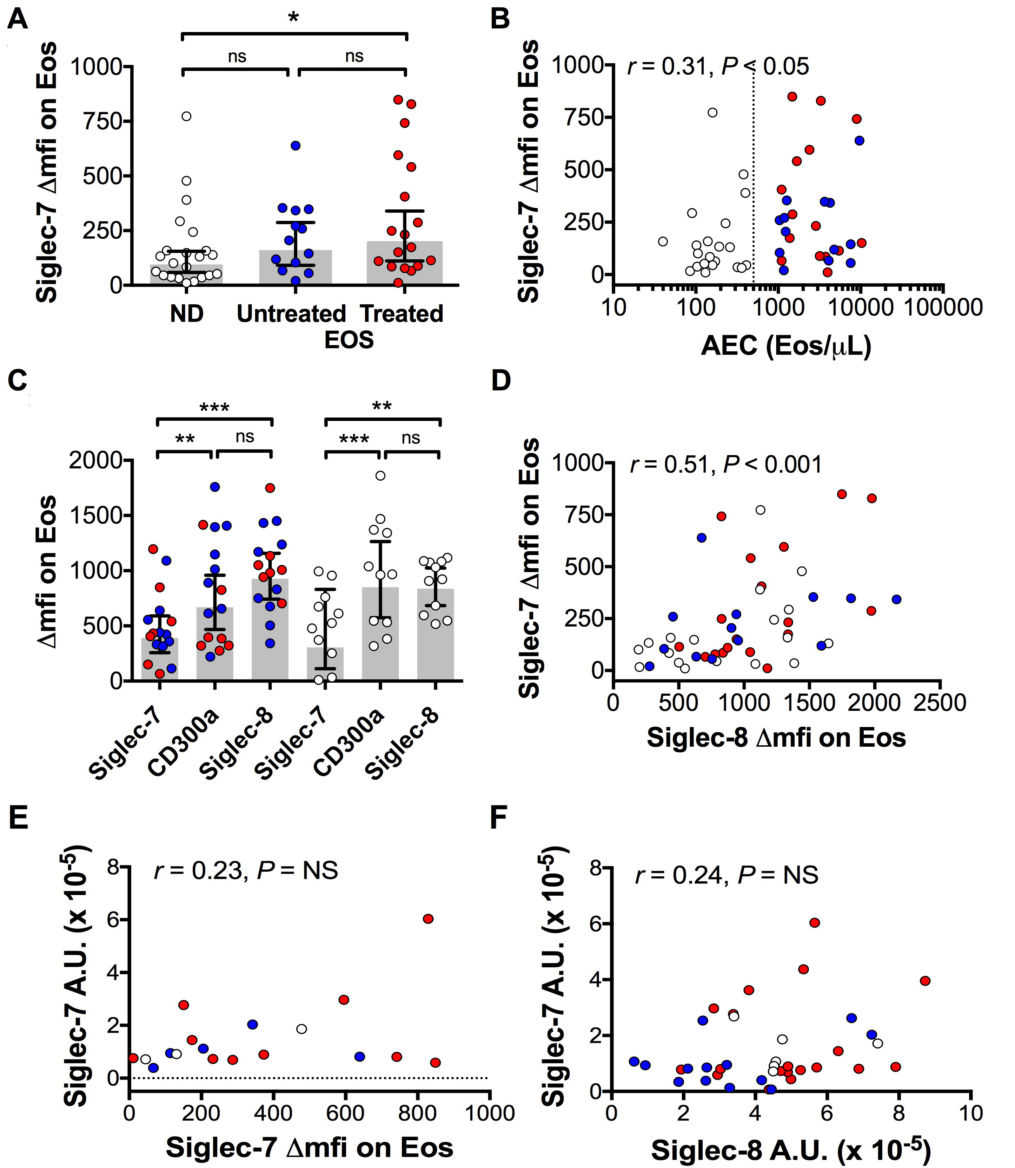
Siglec-7 expression on peripheral blood eosinophils
ND Normal individuals
EOS Eosinophilic donors
Legrand F, Landolina N, and Klion A. Levi-Schaffer F, Submitted

Slide 46
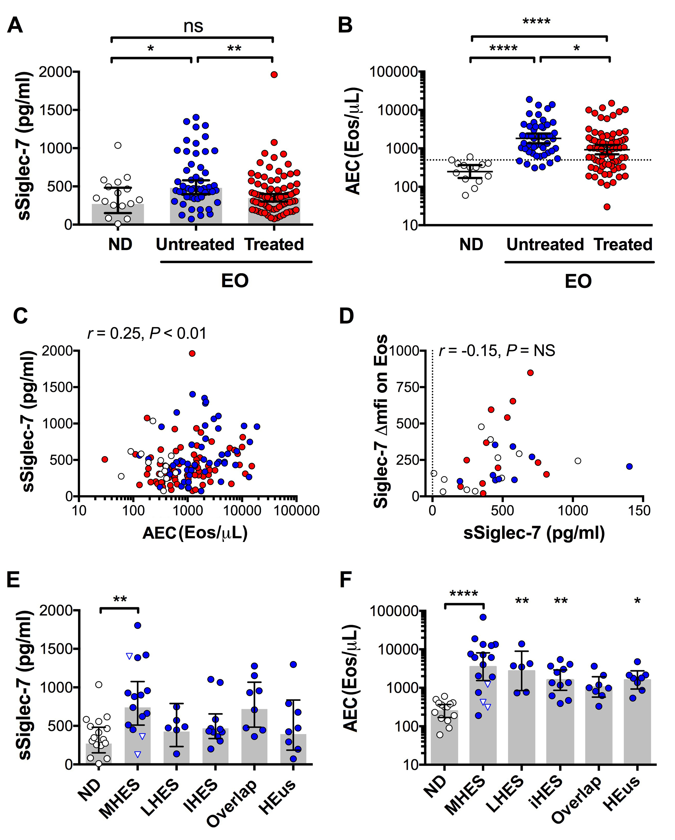
Serum levels of soluble Siglec-7 (sSiglec-7)
ND Normal individuals
EOS Eosinophilic donors
Legrand F, Landolina N, Klion A, Levi-Schaffer F . Submitted

Slide 47
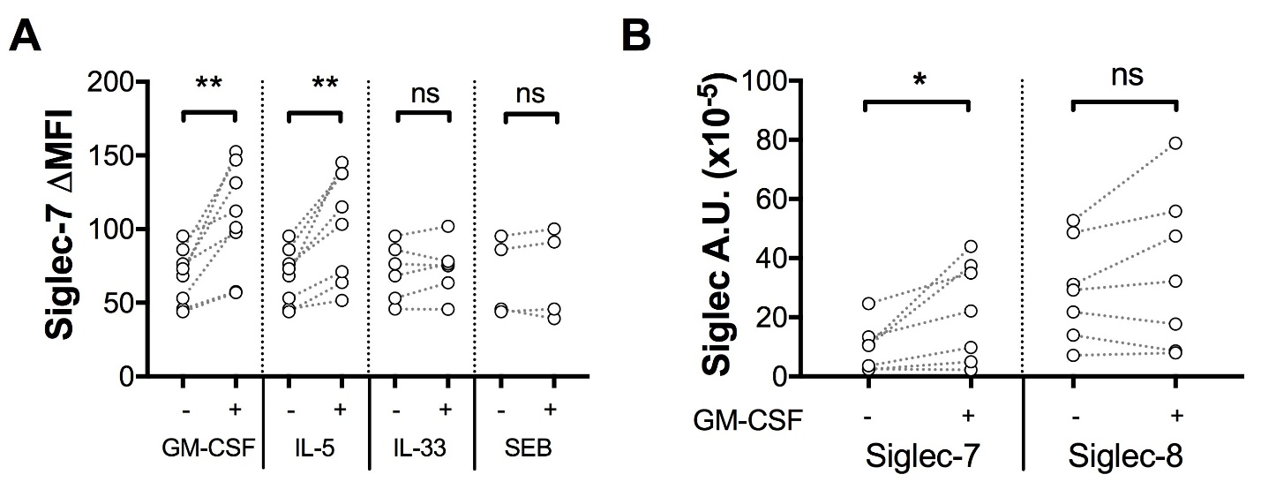
Siglec-7 is upregulated by stimulation with GM-CSF or IL-5
Legrand F, Landolina N, Klion A,. Levi-Schaffer F Submitted

Slide 48
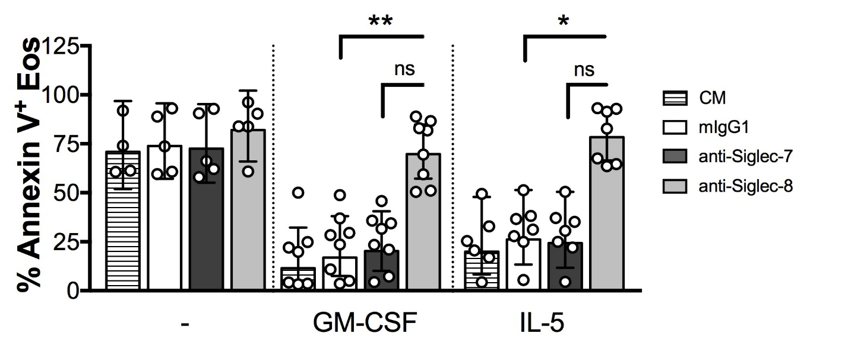

Siglec-7 does not induce eosinophil cell death
Legrand F, Landolina N, Klion AF , Levi-Schaffer Submitted

Slide 49


Crosslinking of Siglec-7 inhibits GM-CSF-induced eosinophil activation
Goat F(ab’)₂ anti- mouse IgG
Mouse anti-Siglec-7
GM-CSF
GM-CSFR
Siglec-7
Activating
Signaling
Inhibitory
Signaling
Legrand F, Landolina N, Klion A, Levi-Schaffer F and. Submitted
Notes:
<number>

Slide 50

Activation of Siglec-7 on eosinophils induces SHP-1 phosphorylation and reduces MAPK phosphorylation in a time-dependent fashion
Legrand F, Landolina N, Klion A, Levi-Schaffer F. Submitted

