Slide 1
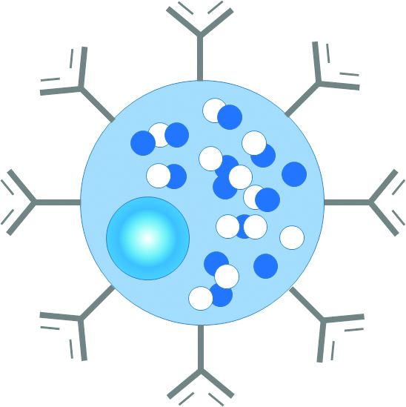
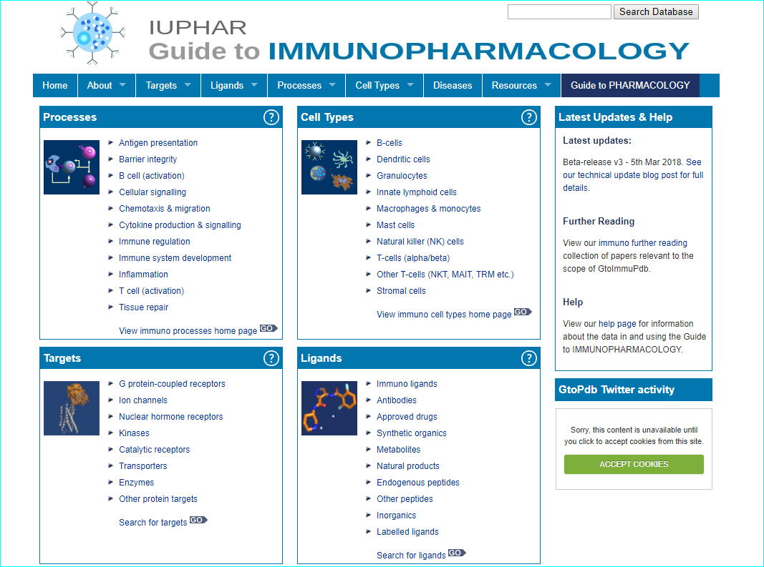
Guide to IMMUNOPHARMACOLOGY
Overview presentation for October 2018 meeting
http://www.guidetoimmunopharmacology.org/immuno/index.jsp
Individual Team Members:
Simon Harding
Chris Southan
Elena Faccenda
Joanna Sharman-Soares
Adam Pawson
Jamie Davies
Notes:
<number>

Slide 2
Development overview
Extends the existing GtoPdb schema with new immuno-relevant data types e.g. Processes, Cell types, Diseases
Modification of submission tool to capture and integrate new data
Extending the web-interface to:
Surface new data types within existing GtoPdb resource
Provide a unique portal into the new data (GtoImmuPdb view)
Extend search mechanisms to encompass new data

Slide 3
Curation sources
Focussed literature searches
Pharma companies pipeline disclosures
Pharma and academic press releases
Clinical trial registries
Selected Twitter sources
INN lists
Patent documents
ArchiveX pre-prints (just initiated)

Slide 4
Literature searching
Most methods we explored worked but had different levels of recall, specificity and efficiency
Magnitude of the challenge indicated by monthly PubMed alert of: “immunology OR "immune system" AND immunomodulation OR immunosuppression OR immunostimulation OR inflammation” typically returning ~ 5000 hits (good recall)
Highest specificity was browsing the contents pages of Journal of Medicinal Chemistry
Highest efficiency was via Twitter from selected journals and immunology society feeds and newsletters
Good specificity during curation of any paper by browsing PubMed “Similar articles” and “Cited by”
The counter-intuative take home was that only a minority of our curated primary reverences came from what we might classify as the ”immunopharmacolgy” literature (see journal distribution in later slide)

Slide 5
Triage and pre-curation
Benefits of using CUL to triage huge data sources
On-line collation of relevant references with curatable entities as targets and/or ligands
Common tags to allow retrieval of combined efforts
Add pre-curation comments (e.g. CIDs, SMILES etc. for ligands; Uniprot IDs for new targets)
Add personal PDFs for full curation
Repository of useful reviews and Hot Topics as further reading
System is open and tags can be shared with anyone
Not restricted to papers (can add any form of text reference)
Caveats
Need to avoid common tags (i.e. use semi-cryptic personal tags)
Inability to cross-comment between users (have to duplicate comments and/or other curator adds separate comments)
No explicit linking between CUL IDs, DOIs, PubMed IDs and our database references
Little active development with Elsevier persistence dependency
Your can see our collections here
http://www.citeulike.org/user/cdsouthan/tag/immpharm http://www.citeulike.org/user/efaccenda

Slide 6
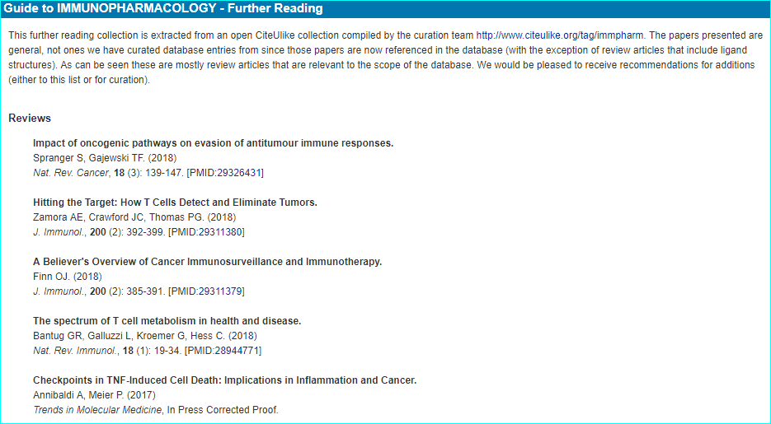
CUL-tagged papers > further reading

Slide 7
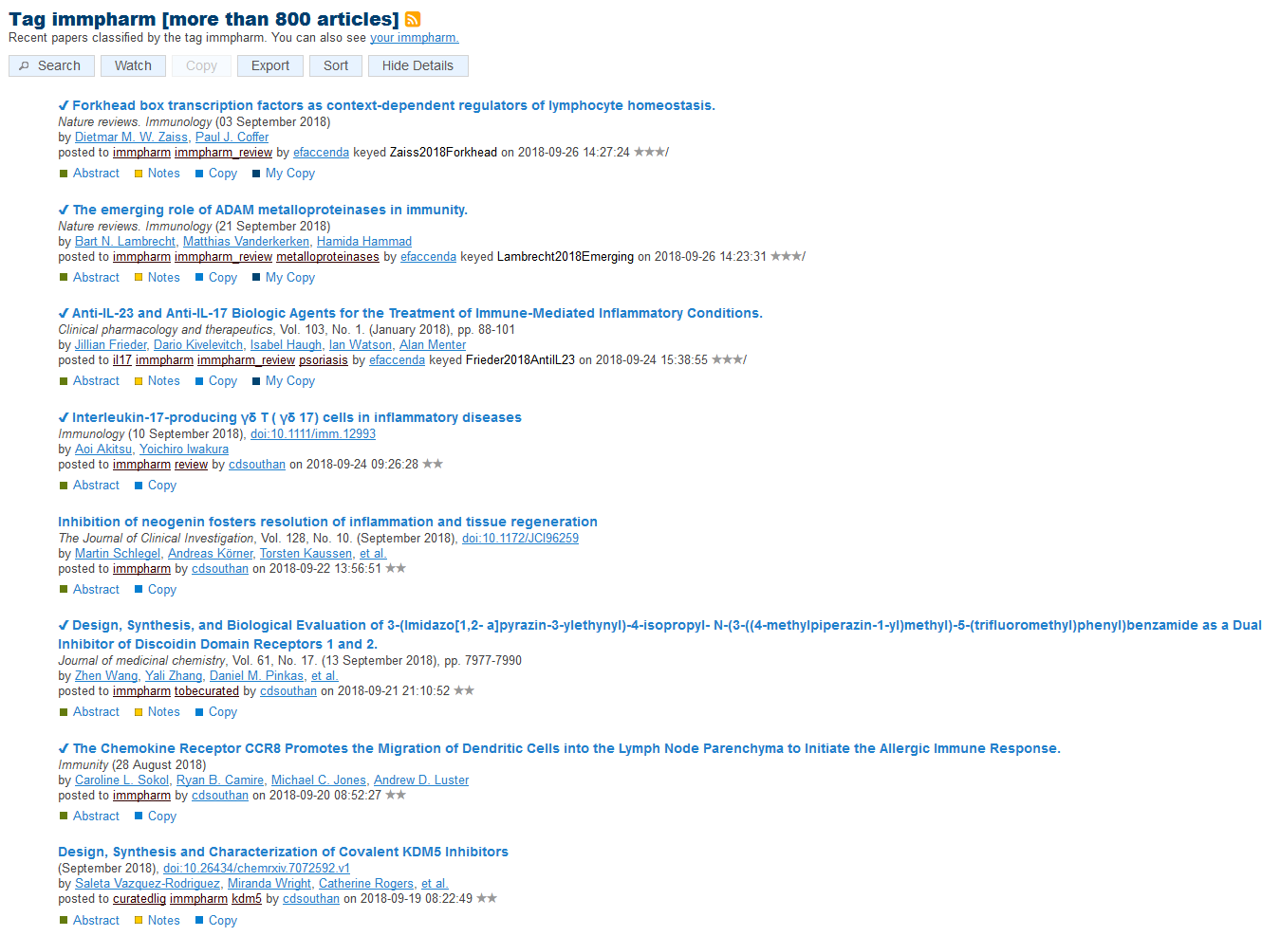
Shared tags

Slide 8
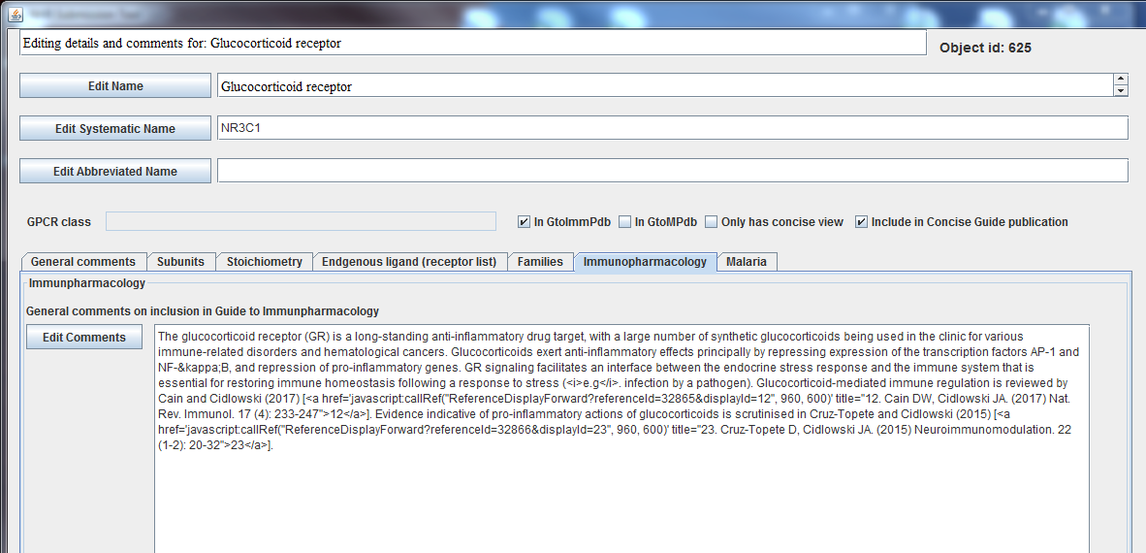
Target Curation
Target curation (1)
Text field to allow manual curation of descriptive information and supporting literature references
Tag to allow retrieval of all GToImmuPdb targets

Slide 9
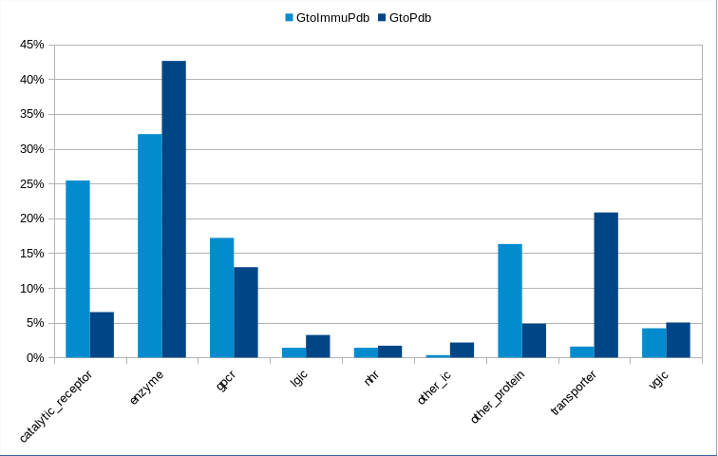
Target curation (2)
Breakdown of targets tagged in GtoImmuPdb by target class
568 targets in GtoImmuPdb
Enzymes | 183
Catalytic Receptors | 145
GPCRs | 98
Other Proteins | 93
VGICs | 24
Transporters | 9
NHRs | 8
LGICs | 8
Comparing distribution of targets in GtoImmuPdb against all other targets in GtoPdb
Y-axis shows percentage of targets.
GtoImmuPdb is over-represented by Catalytic Receptors and Other Protein classes

Slide 10
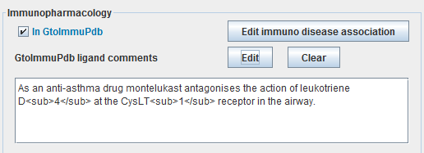
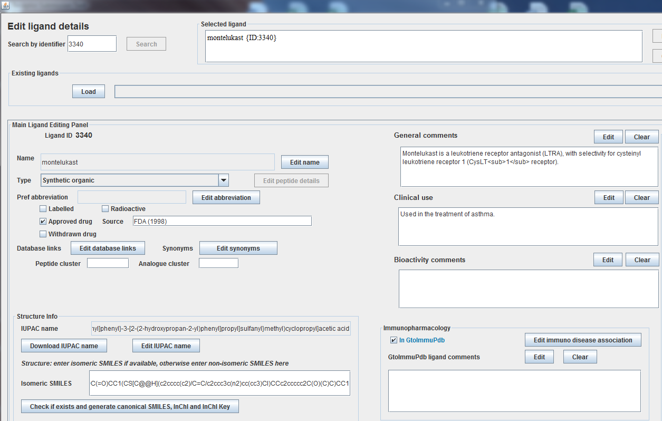
Ligand curation (1)
Text field to allow manual curation of contextual comments
Fields to allow manual ligand>disease association and comments
Tag to allow retrieval of all GToImmuPdb ligands

Slide 11
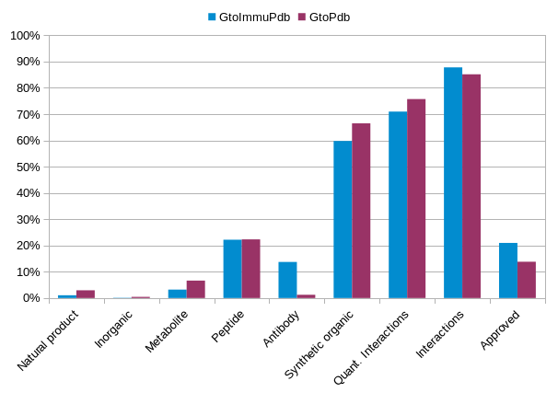
Ligand curation (2)
Breakdown of ligands tagged in GtoImmuPdb by type. Includes count of approved drugs
1068 ligands in GtoImmuPdb
Synthetic Organic | 640
Peptides | 236
Antibodies | 146
Metabolite | 34
Natural Products | 11
Inorganic | 1
Approved Drugs | 236
Comparing distribution of ligands in GtoImmuPdb against all other ligands in GtoPdb
Y-axis shows percentage of ligands
GtoImmuPdb is over-represented by Antibodies compared to GtoPdb. It also has a slightly higher proportion of approved drugs

Slide 12
GtoImmuPdb ligands in PubChem
PubChem is the single most important global resource to surface our GtoImmuPdb ligands
We have exellent collaborative contacts with the PubChem from our GtoPdb history of submissions for every release
We have introduced a series of tags that PubChem users can exploit for sub-setting our ligand entries (see stats below)
Note also our linkages present a ”virtuos cirle” for connectivity between GtoP, PubChem and PubMed, from the references we curate for our ligand entries
Headline stats associated with GtoPdb releas 2018.4 are as follows:
All substances (SIDs) = 9414 (includes antibodies, small proteins and larger peptides)
Small-molecule compounds (CIDs) = 7249
Approved drugs (human use) = 1480
CIDs unique to us as a source = 164
Antibodies (clinical) all = 247
Headline stats associated with GtoImmuPdb
All substances (SIDs) = 1064
Small-molecule compounds (CIDs) = 687
Approved drugs = 259
Antibodies = 145
Approved antibodies = 78

Slide 13
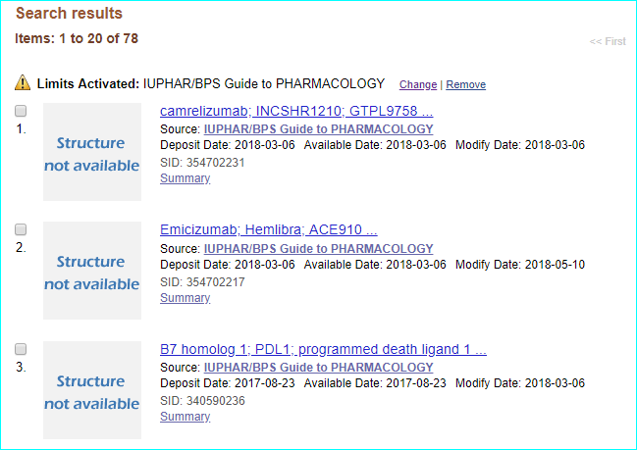
PubChem example (1)
Substance side query “approved AND antibody AND "IUPHAR/BPS Guide to PHARMACOLOGY"[SourceName]”

Slide 14
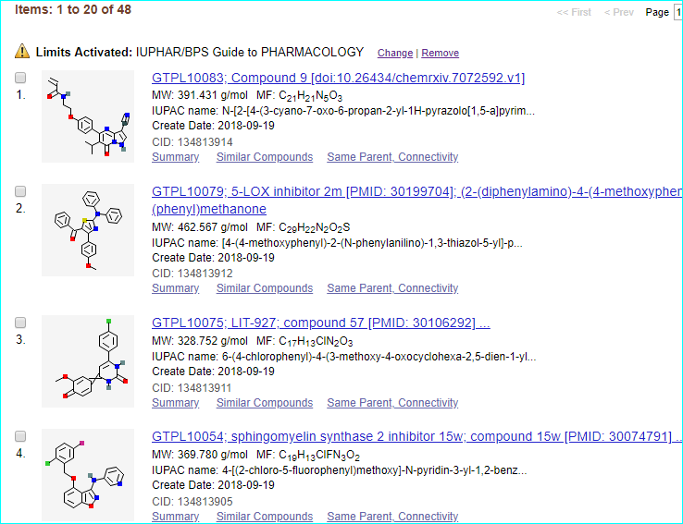
PubChem example (2)
"IUPHAR/BPS Guide to PHARMACOLOGY"[SourceName]” as CIDs from “immunopharmacology, select for unique to us, and sort by date

Slide 15
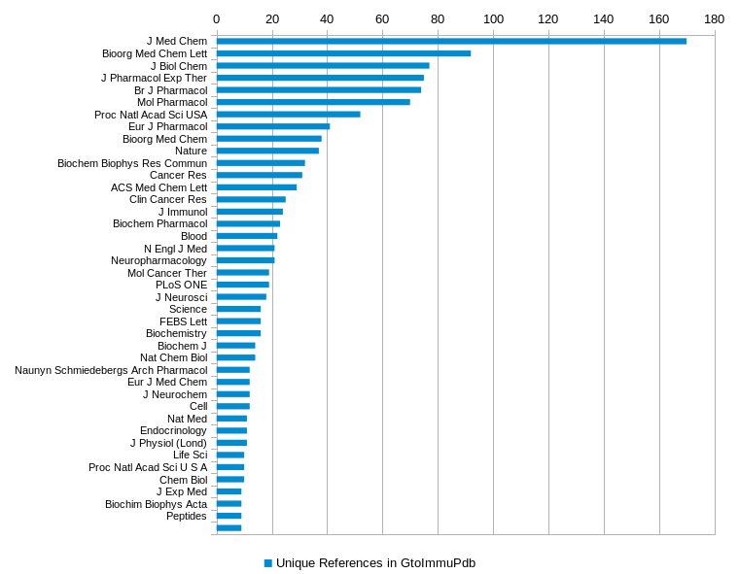
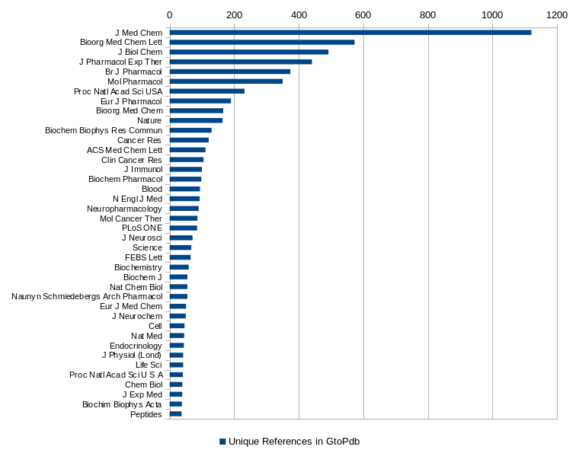
Publication counts

Slide 16
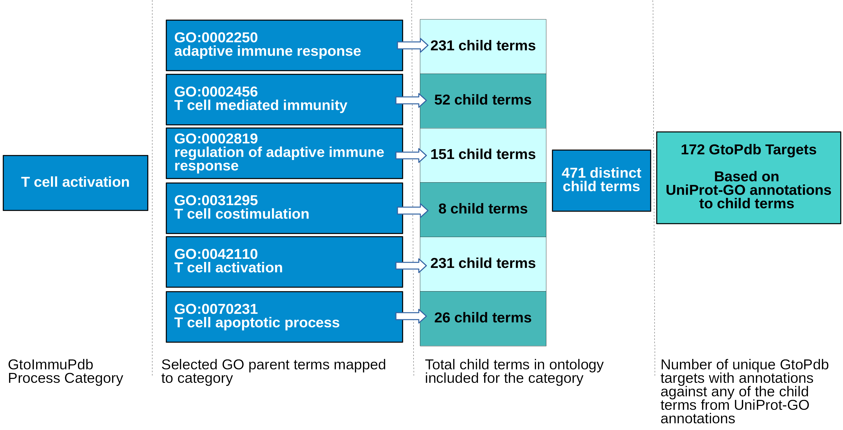
Annotating processes via GO
195
Targets associated with top-level immunological process categories
Parent Gene Ontology (GO) terms mapped to categories
Auto-curate targets annotated to any of those GO terms (or their children)
GO annotations downloaded from UniProt
GO ontology terms obtained from (http://purl.obolibrary.org/obo/go.obo)

Slide 17
Immuno process data (1)
Immuno Process Category | GtoPdb Human UniProtKB | GO Annotations
Antigen presentation | 178 | 260
B cell (activation) | 156 | 261
Barrier integrity | 47 | 63
Cellular signalling | 480 | 1177
Chemotaxis & migration | 266 | 491
Cytokine production & signalling | 504 | 1347
Immune regulation | 481 | 1252
Immune system development | 240 | 428
Inflammation | 630 | 1434
T cell (activation) | 195 | 418
Tissue repair | 21 | 21

Slide 18
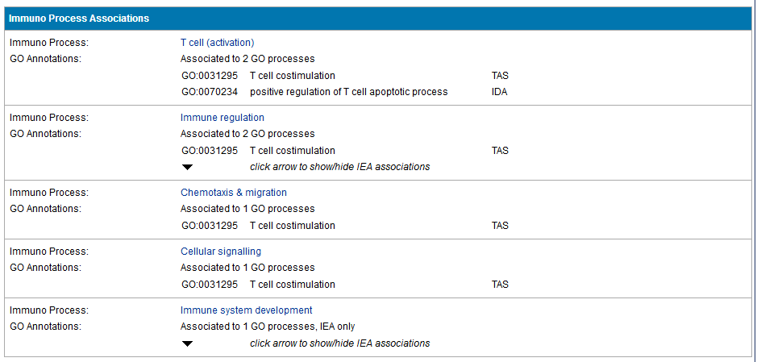
Immuno process data (2)
Processes auto-curated for the PD-1 checkpoint protein
GO evidence codes
= Traceable Author Statement
= Inferred from Direct Assay
= Inferred from Electronic Annotation; automated- no curatorial judgement

Slide 19
Immuno cell type data(1)
Cell type category | Targets annotated
B cells | 47
Dendritic cells | 37
Granulocytes | 40
Innate lymphoid cells | 2
Macrophages & monocytes | 53
Mast cells | 37
Natural killer cells | 22
Other T cells | 3
T cells | 69
Stromal cells | 1

Slide 20
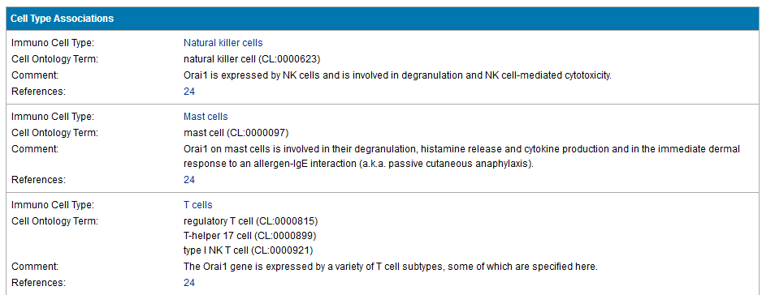
Immuno cell type data (2)
Cell types manually curated as expressing the Orai1 ion channel

Slide 21
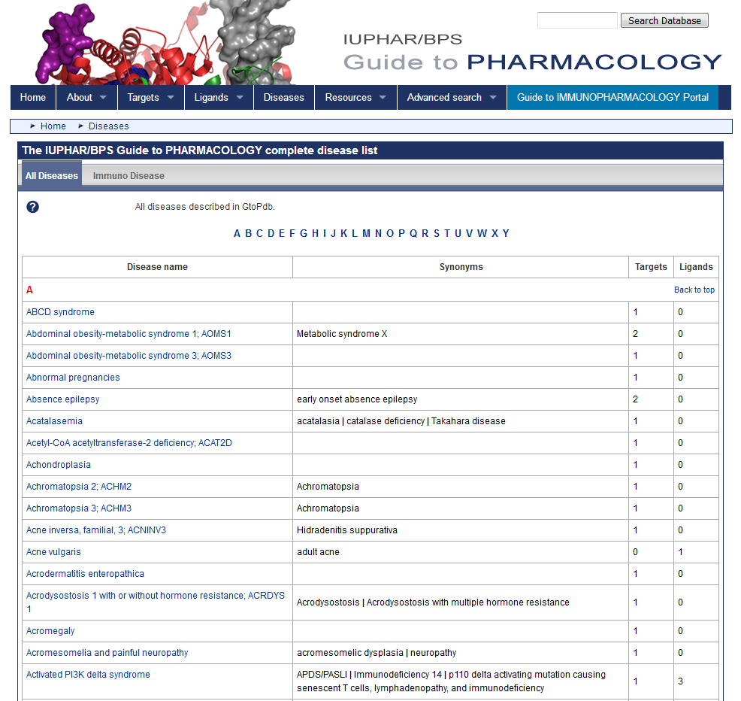
Disease pages
Developed for GtoImmuPdb but implemented across the wider data set held in the GtoPdb

Slide 22
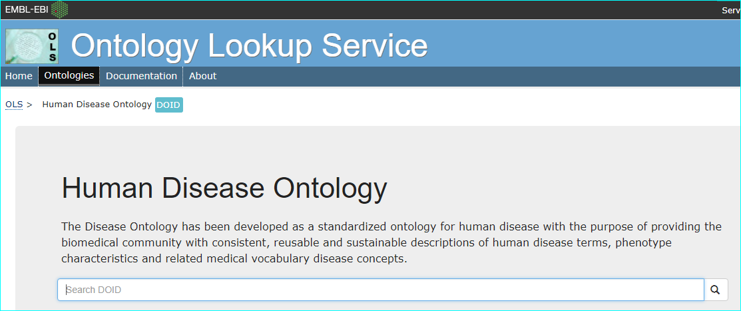
Disease data
 | Disease Associations | Targets/Ligands | Diseases
Targets | 55 | 37 | 29
Ligands | 708 | 401 | 103

Slide 23
Annotated diseases
Disease Associations to Targets and Ligands: Disease with most associations
Disease | Targets |  | Disease | Ligands
Rheumatoid arthritis | 11 |  | Rheumatoid arthritis | 125
Asthma | 6 |  | Asthma | 77
Osteoarthritis | 5 |  | Psoriasis | 56
Acute myeloid leukemia | 3 |  | Chronic obstructive pulmonary disease | 42
Psoriasis | 2 |  | Crohn's disease | 26
Irritable bowel syndrome | 2 |  | Osteoarthritis | 25
Acute lymphocytic leukemia (ALL) | 2 |  | Systemic lupus erythematosus | 23
Behcet syndrome | 2 |  | Ulcerative colitis | 21
Multiple sclerosis | 2 |  | Psoriatic arthritis | 16
 |  |  | Atopic dermatitis | 15
 |  |  | Dermatitis | 14
 |  |  | Ankylosing spondylitis | 14
 |  |  | Allergic rhinitis | 13
 |  |  | Relapsing-remitting multiple sclerosis | 12
 |  |  | Chronic lymphocytic leukemia | 11
 |  |  | Allergic urticaria | 9
 |  |  | Allergic conjunctivitis | 8
 |  |  | Inflammatory bowel disease 1; IBD1 | 8
 |  |  | Graft versus host disease | 7
 |  |  | non-Hodgkin lymphoma | 7

Slide 24
GtoImmuPdb growth (1)
 | May 2016 | Oct 2016 | Mar 2017 | June 2017 | Nov 2017 | Jan 2018 | Mar 2018 | Apr 2018 | Sep 2018
Targets | 54 | 99 | 406 | 448 | 475 | 493 | 509 | 523 | 568
Ligands | 79 | 195 | 553 | 776 | 856 | 910 | 920 | 985 | 1068
Ligands associated to disease | 0 | 0 | 219 | 324 | 342 | 349 | 362 | 386 | 401
Targets associated to disease | 0 | 0 | 11 | 22 | 24 | 24 | 25 | 35 | 37
Targets associated to processes | 0 | 401 | 448 | 828 | 884 | 928 | 941 | 941 | 979
Targets associated to cell types | 0 | 0 | 86 | 105 | 106 | 109 | 116 | 117 | 147
We retrospectively GToImmuPdb-tagged 488 existing GToPdb targets and 594 existing ligands

Slide 25
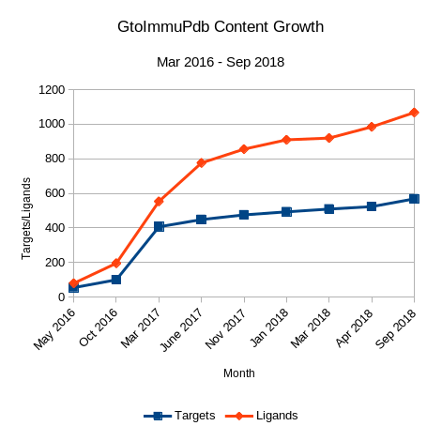
GtoImmuPdb growth
17% of existing (pre-2015) GToP targets were retrospectively tagged for GToImmuPdb.
Since 2015, the percentage of new targets added and tagged for GToImmuPdb is ~60% (80 out of the 129 added)
For ligands, 7.2% of pre-2015 entries were retrospectively GToImmuPdb-tagged, this has increased to 40% of new ligands (475 out of 1205 added).
These figures illustrate the shift in focus to ‘immuno’ relevant data.

Slide 26
Achievements and plans
Achievements outlined in external slides, posters, database report and NAR paper (PMID: 29149325)
Good progress leading up to beta release
Need to broaden feedback
Need more committee (and other expert) inputs for
Triaging “Further Reading” for the birds eye picture
More dot-joining on “big themes” (e.g. athero, AD, depression)
Check false-negatives (i.e. do we have a “coverage gap”)
Engage with key wet labs (e.g. for ligand testing in new systems)
Continue getting the word out (e.g. papers and press release)
Explore crowd-source options (e.g. call for papers)

Slide 27
Technical issues and challenges
Assessing publication quality in immunopharmacology is even more difficult than for general pharmacology
Ditto for the “reproducibility crisis” w.r.t. to ligand quantitative activity
As ever, the rate of blinding for pharma development candidates is ~40% (i.e. no name-to-structure)
We do not curate without a defined molecular structure for ligands (even if we have to dig out an antibody sequence from a patent)
Difficult for users to differentiate where the target has different (or even the same) ligands published in both immunopharmacolgy and other therapeutic contexts
Diseases that are mechanistically “grey” but potentially large (e.g. fibrosis as immunological causality?)
Single-cell expression data will eventually split our cell hierachies

Slide 28
Sustainability and resourcing
Our 2015 Wellcome Trust Grant for the Guide to Immunopharmacology expires at the end of October 2018
This reduces the project headcount in Edinburgh by three positions
GtoImmuPdb can be sustained and moderately expanded after Oct but at ~50% less capacity than when initiated
Implications and options need to be considered
Notes:
<number>

