Slide 1

Treatment approaches in the
human type I interferonopathies
Yanick Crow
Notes:
<number>

Slide 2
“We’re all mutants, basically. It’s hard to find a wild type.”
Sydney Brenner (2008)

Slide 3
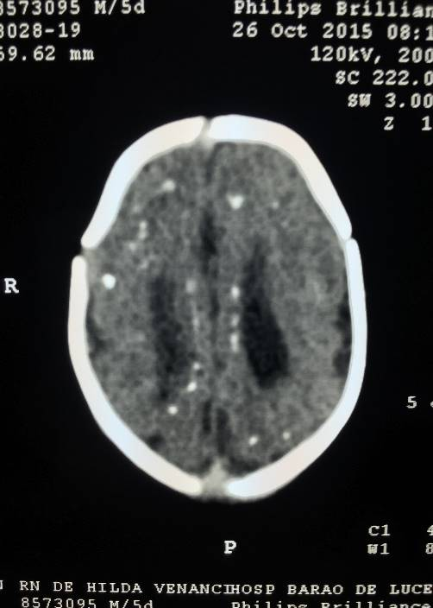
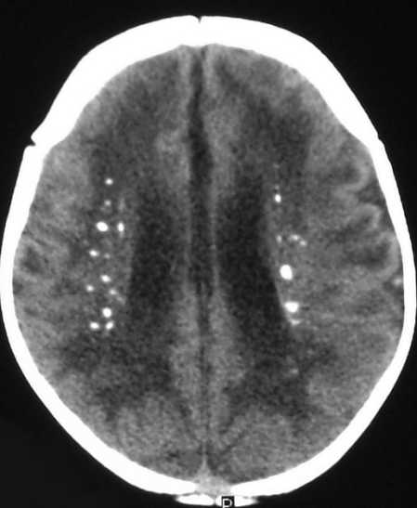
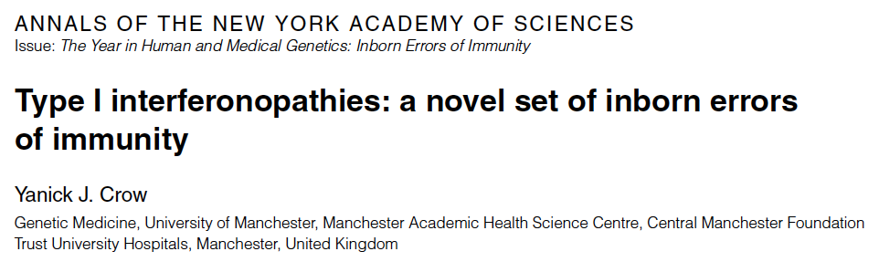
Self versus non-self
DNA
RNA
Type I interferon
Infection
(Zika)
Mendelian
(AGS)
Antiviral activity
Autoinflammation
Notes:
<number>

Slide 4
Insights into antiviral signalling, self / non-self discrimination and the basis of ‘complex’ autoinflammatory / autoimmune disease states
Notes:
<number>

Slide 6
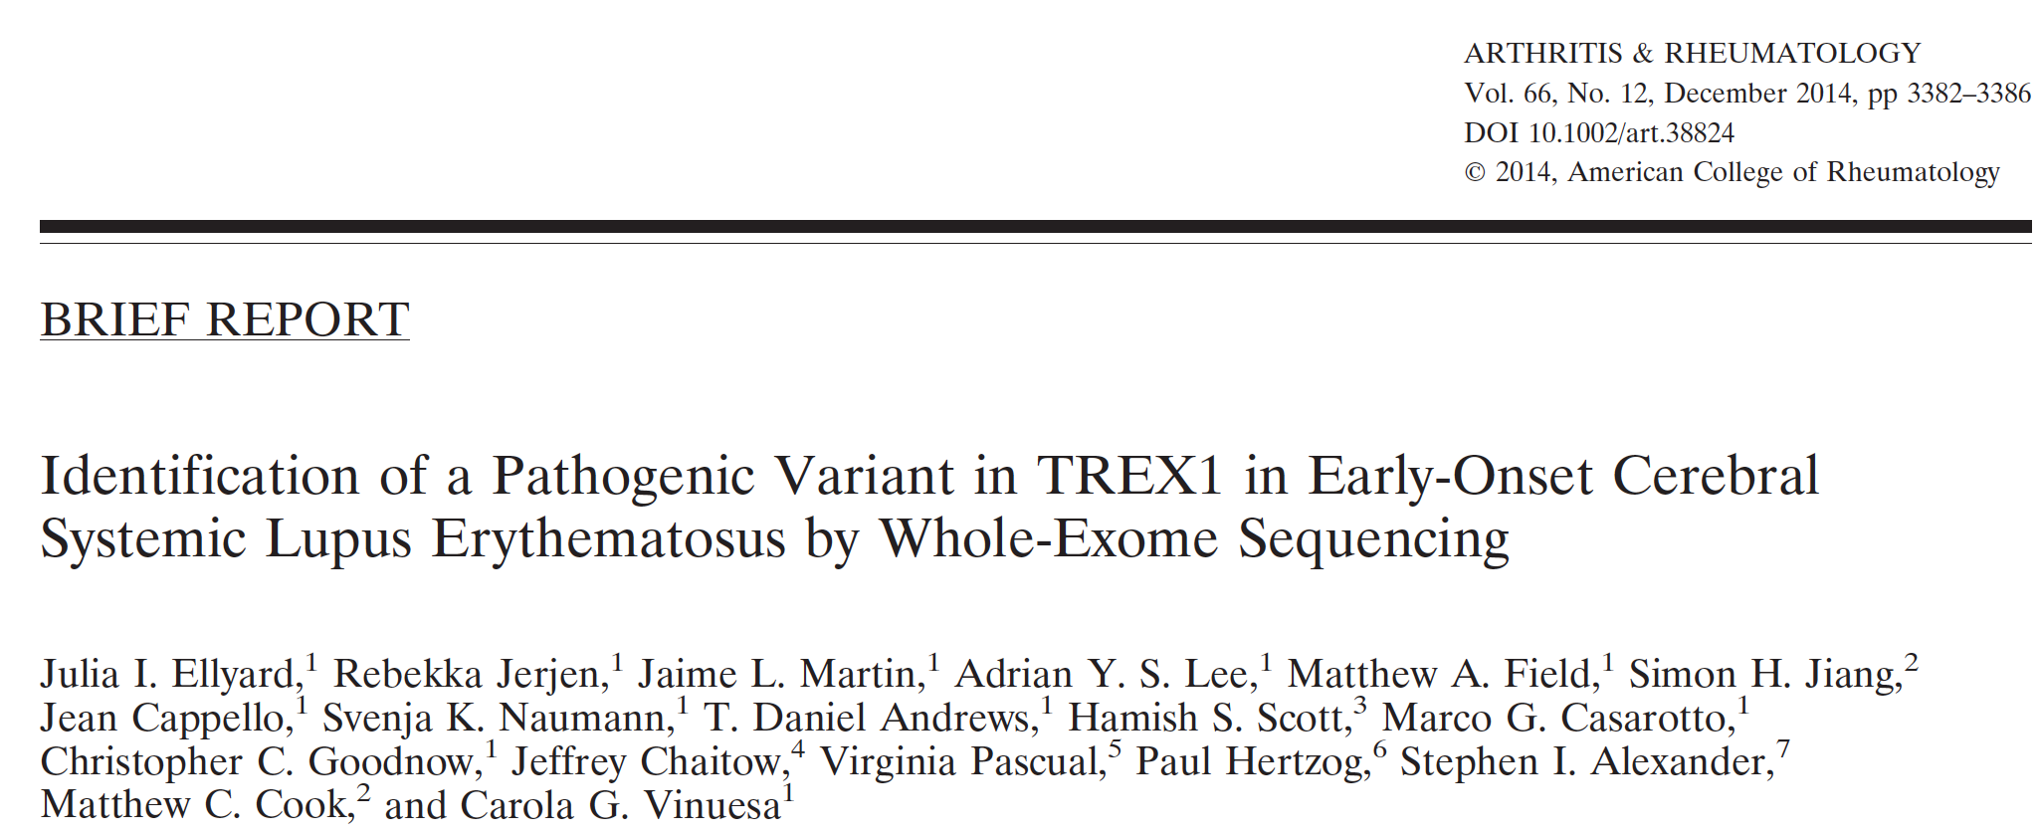

Slide 8
Human type I interferonopathies
Monogenic disorders in which an upregulation of a type I interferon response may be directly relevant to disease pathogenesis
Notes:
<number>

Slide 9
Human type I interferonopathies
An hypothesis
Notes:
<number>

Slide 10
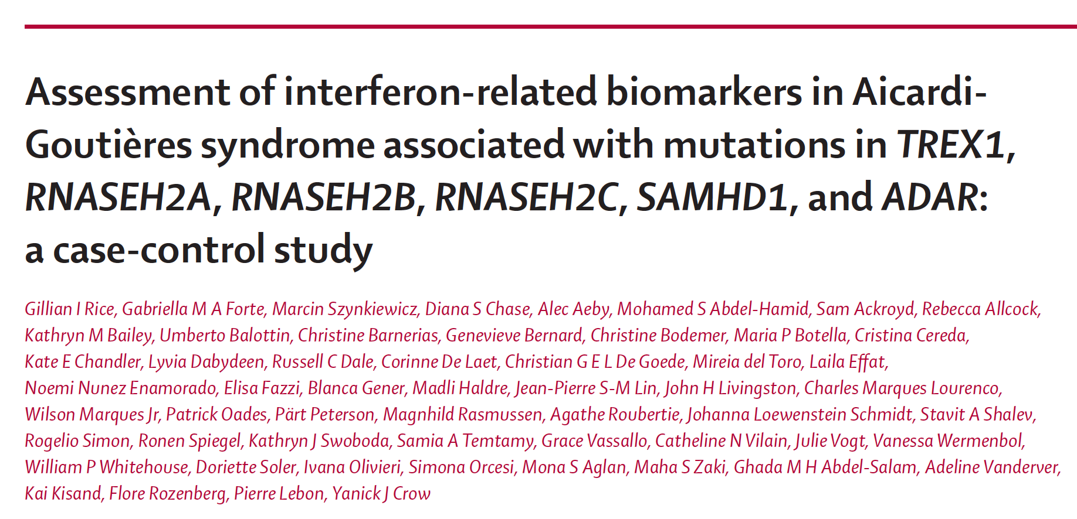

Slide 11
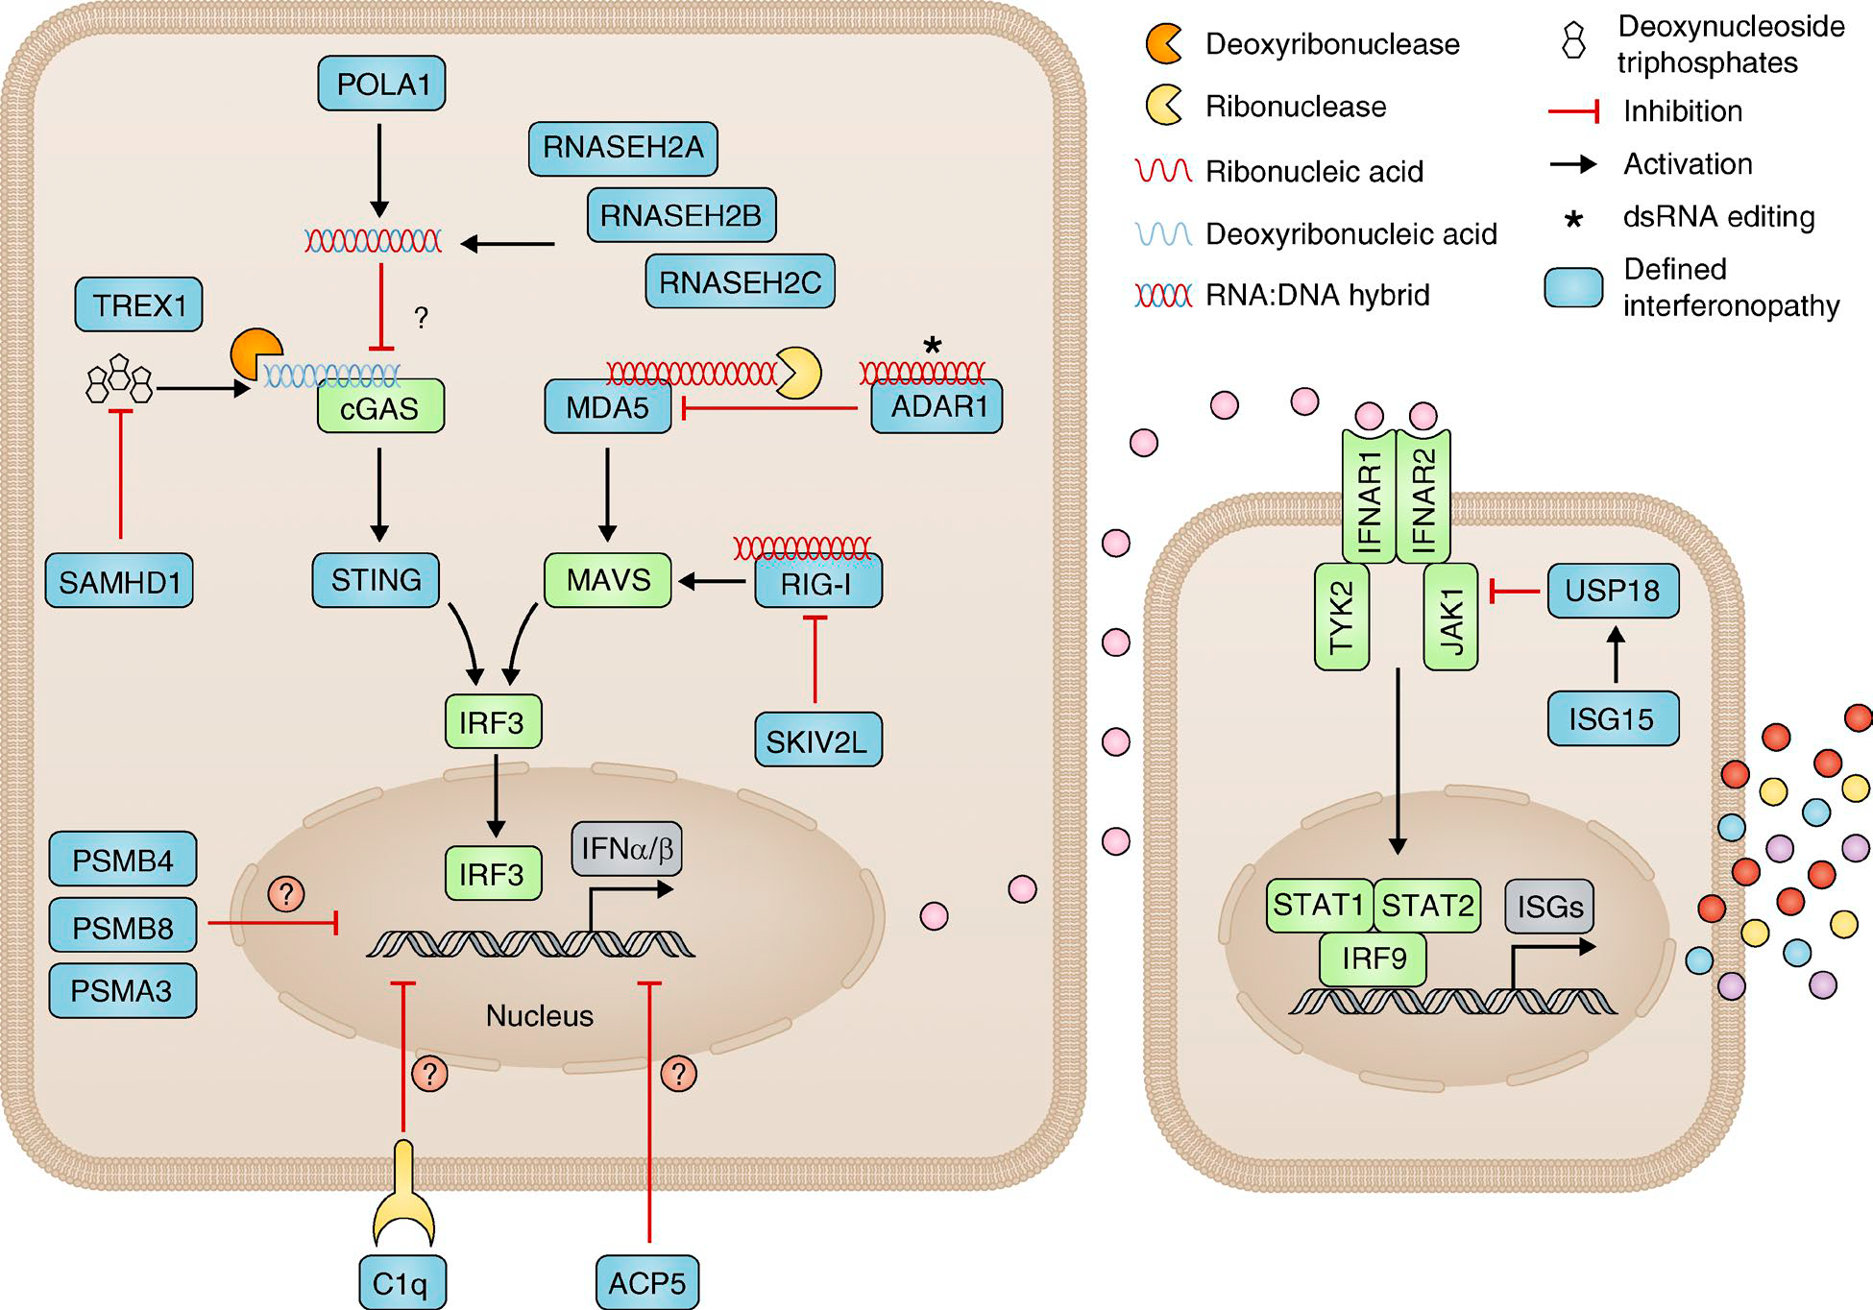
DNASE2

Slide 12
DNA sensing via STING (6)
RNA sensing via MAVS (4)
TREX1
RNASEH2A RNASEH2B RNASEH2C SAMHD1
DNASE2
STING
ADAR1
SKIV2l
MDA5
RIGI

Slide 13
DNASE2
1. Self ‘waste disposal’
2. Self ‘marking’
3. Compartmentalisation
4. Changes in sensing thresholds
Notes:
<number>

Slide 14
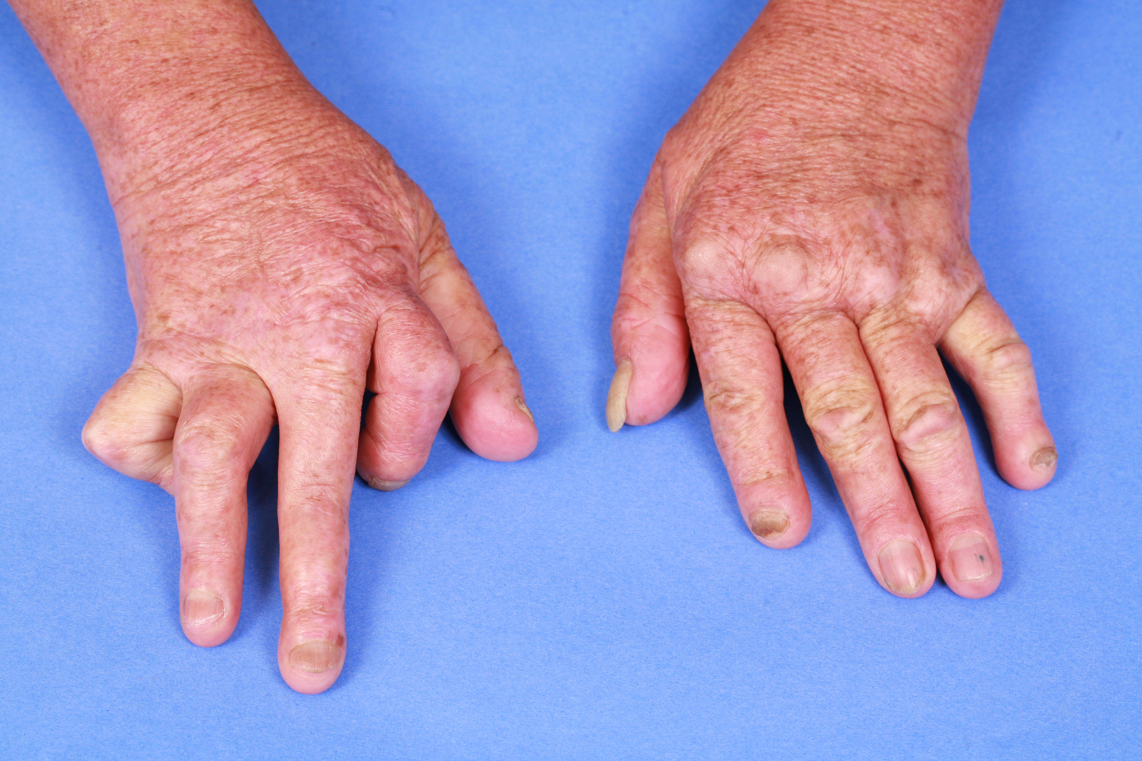
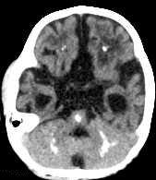
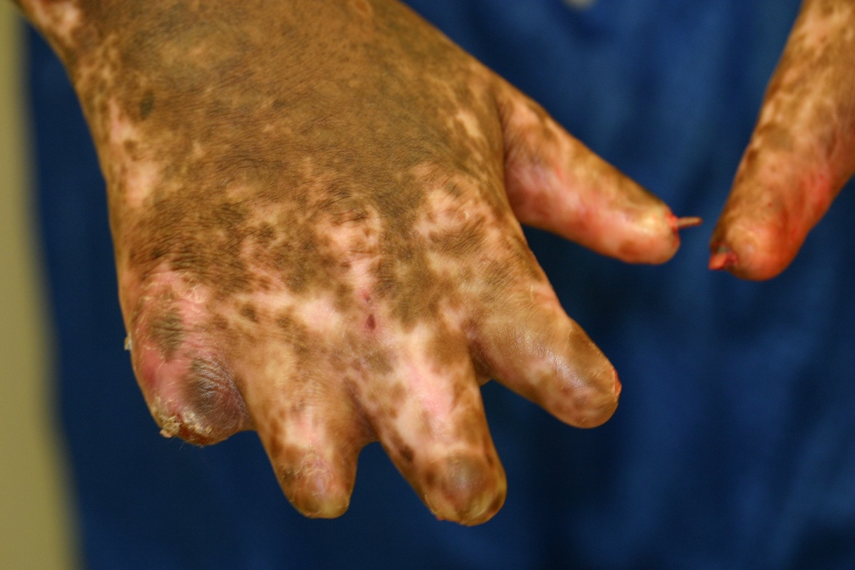
Notes:
<number>

Slide 16

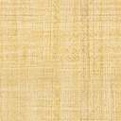
Non-interferon-mediated
Phenotype B
Phenotype A
Interferon-mediated

Slide 17
Nucleic acid driven inflammation

Slide 18
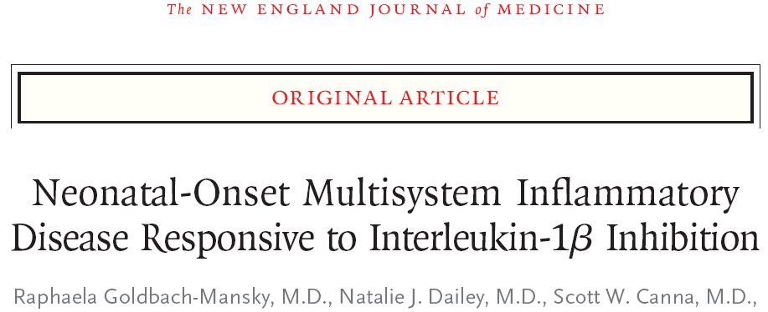

Slide 19
STING | Necker cohort (N = 16) | Literature (N = 17 published) | Not published
Biologics (number of the patients treated) | 7/16 anti cytokines: 5 anti TNFa: 3 anti IL1: 2 anti IL6: 3 | 6/17 anti cytokines: 6 anti TNFa: 6 anti IL1: 1 anti IL6: 1 | anti cytokines: 3 anti TNFa: 2 anti IL1: 1 anti IL6: 1

Slide 20
Notes:
<number>

Slide 22
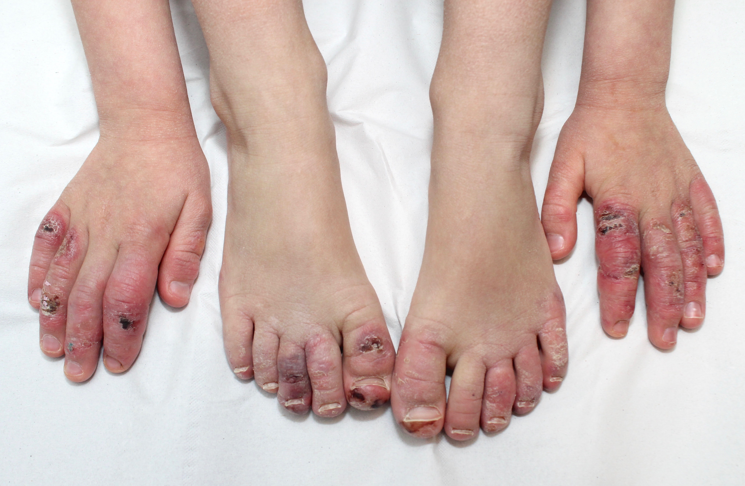
TREX1
Bénédicte Neven

Slide 23
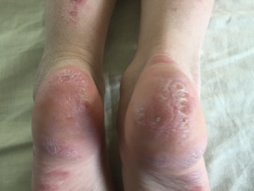
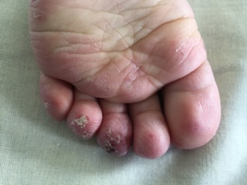
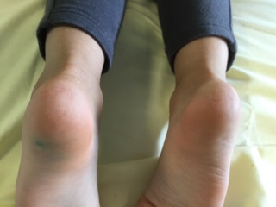
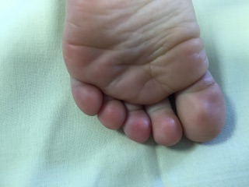
D0
M2.5

Slide 24
D0
M2.5

Slide 25

February 2016 (5 months of treatment)
August 2016 (11 months of treatment)

Slide 27
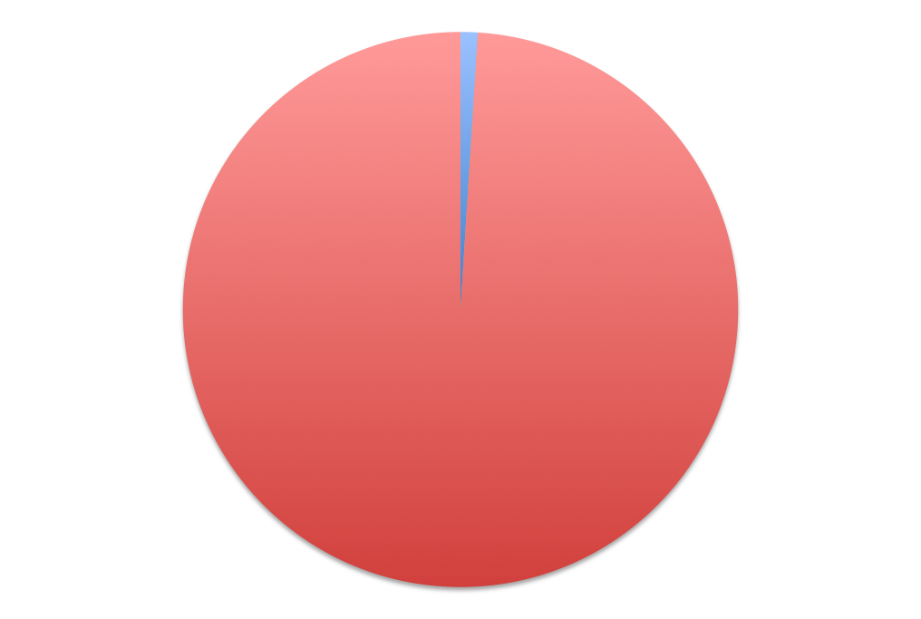
The conceptual distinction between self and non-self breaks down when considering endogenous retroelements
HUMAN GENOME
Genes
Non-coding

Slide 30
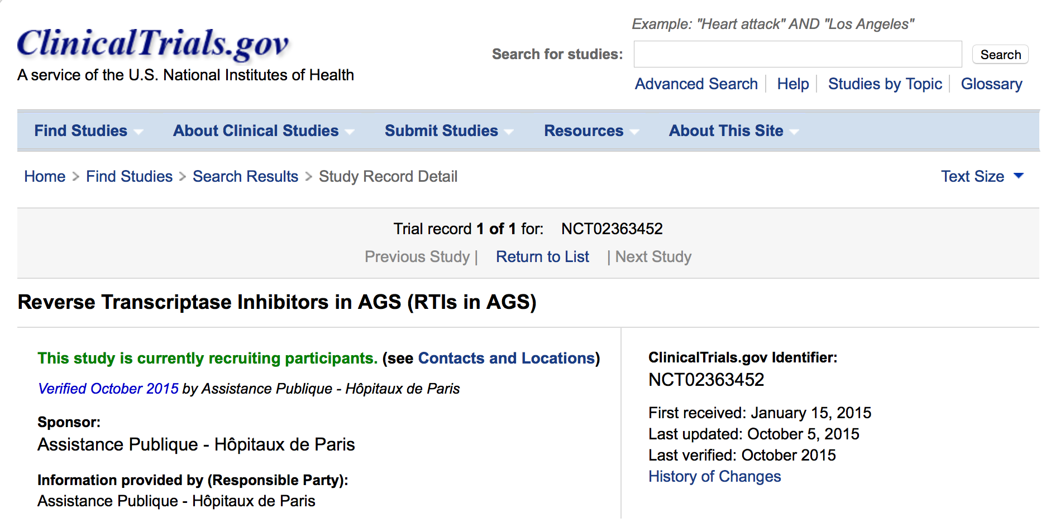

Slide 31
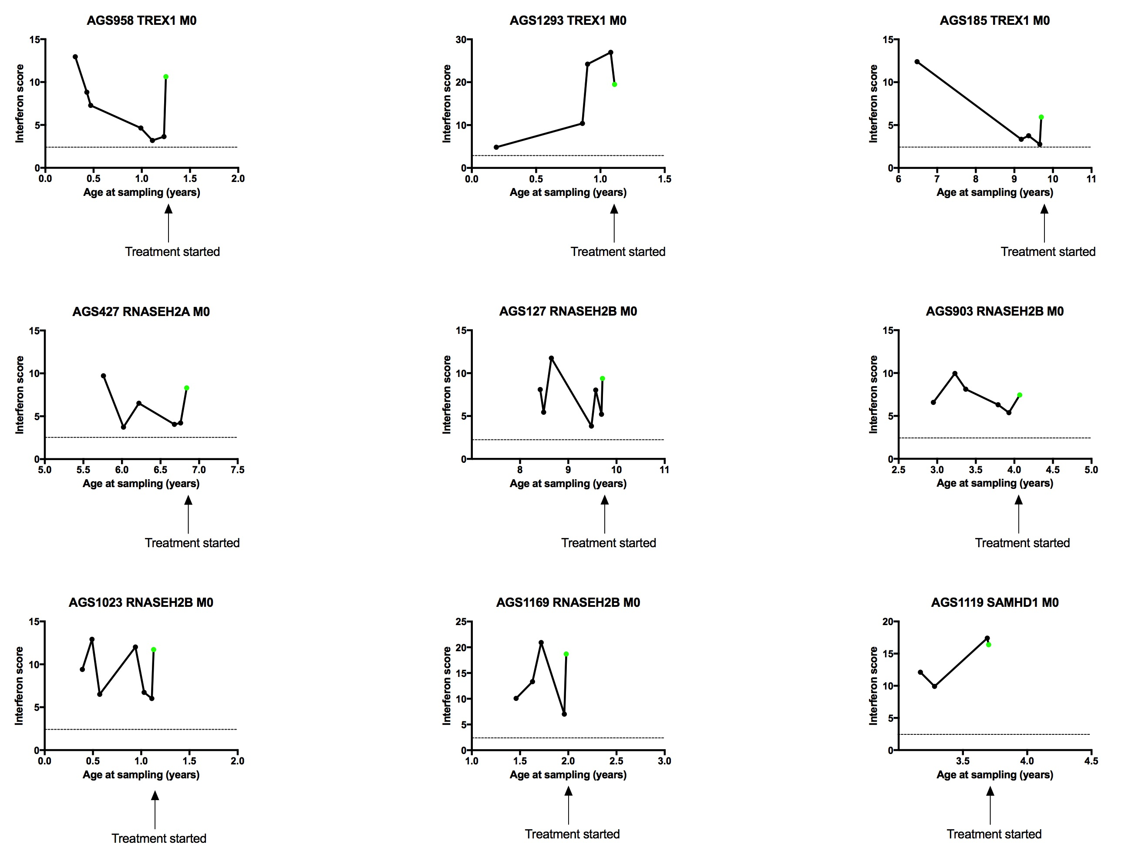

Slide 32
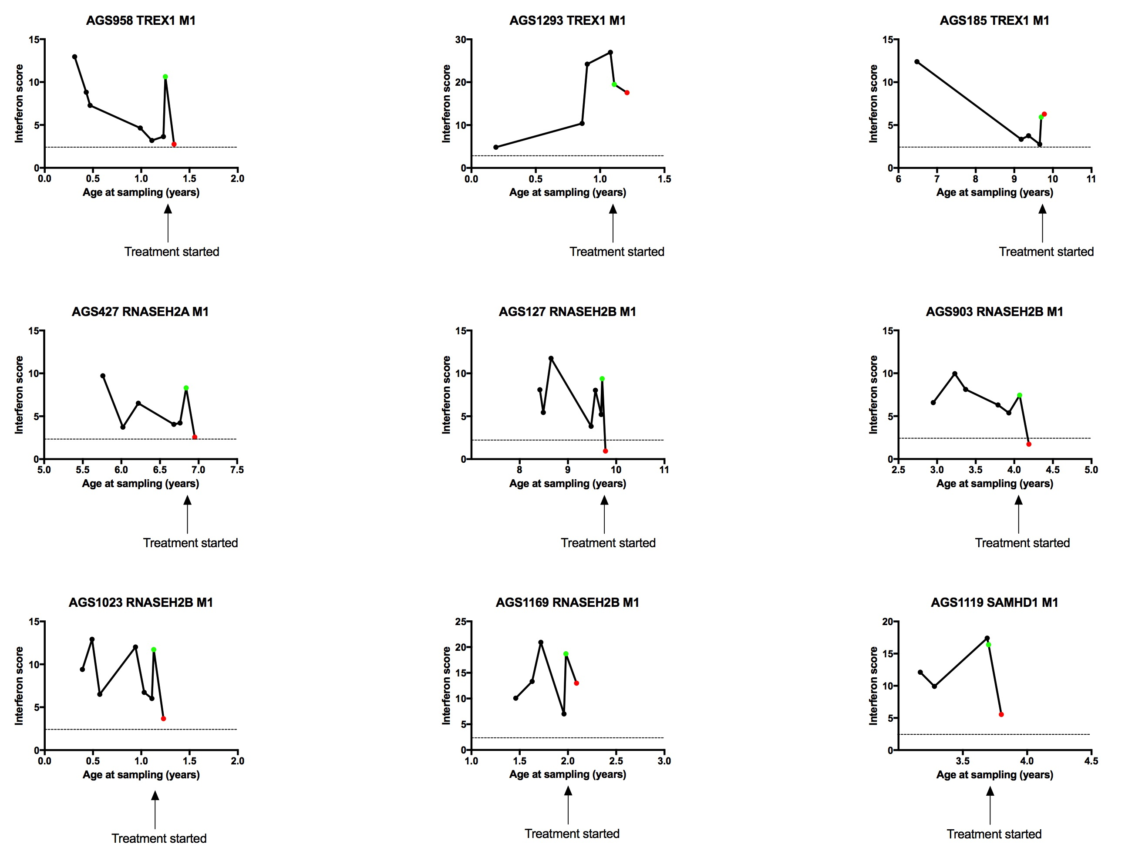

Slide 34
7
6
7
6
7
4

Slide 42
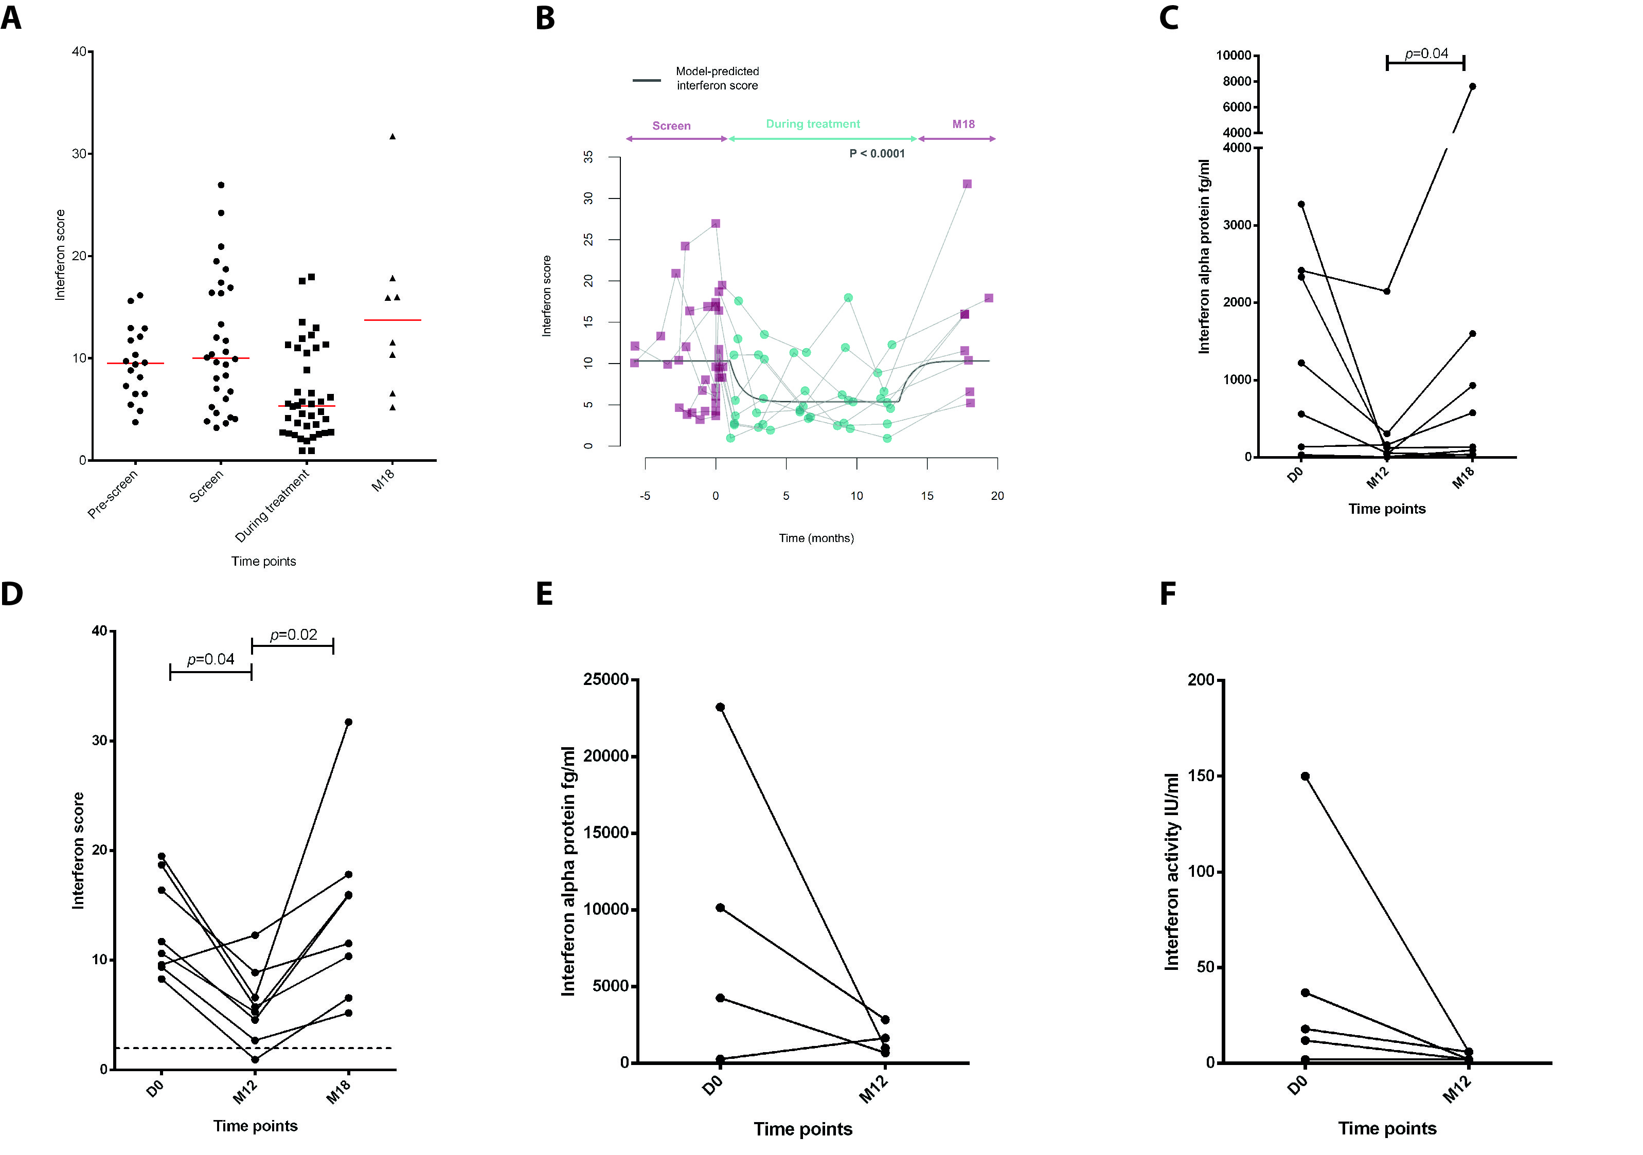
Rice et al. NEJM in press

Slide 43

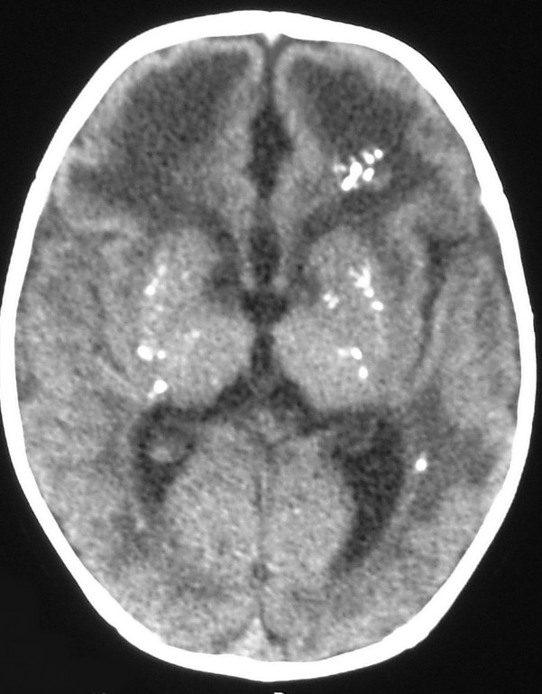


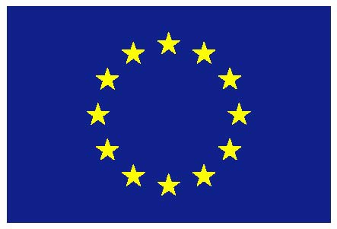
Edinburgh
Carolina Uggenti
Marine Depp
Institut Imagine, Paris
Marie-Louise Frémond
Luis Sebra
Isabelle Melki
Hôpital Necker, Paris
Brigitte Bader-Meunier
Bénédicte Neven
Stéphane Blanche
Manchester
Gillian Rice
Leeds
John Livingston
Institut Pasteur, Paris
Darragh Duffy
Vincent Bondet
All collaborating physicians and patients
Notes:
<number>

